Slide 1

High-speed downstream jets: relevance to bow shock dynamics & evolution Savvas Raptis Johns Hopkins University Applied Physics Laboratory, Laurel, Maryland, USA KTH - Space and Plasma Physics, Stockholm Sweden IAGA/IUGG 2023 A13: Magnetospheric Boundary Layers 13-18 July 2023

Slide 2
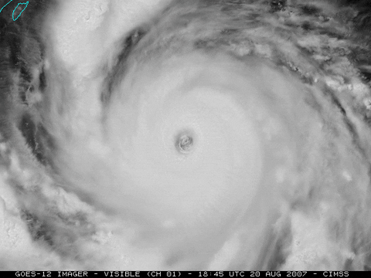


Transient events – weather
Hurricanes
Rain
Snowstorms

Slide 3
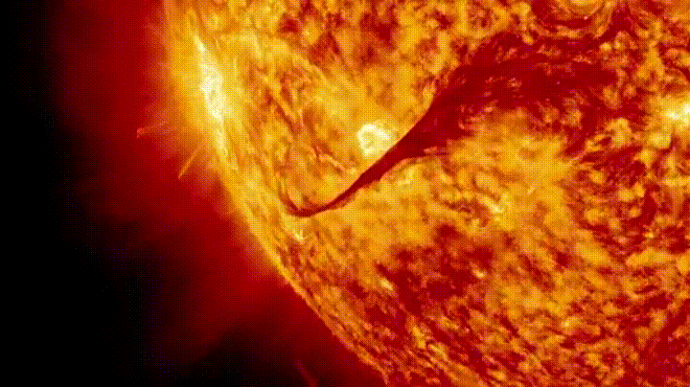
Transient events – weather
CMEs/Solar Flares
Rain
Snowstorms

Slide 4
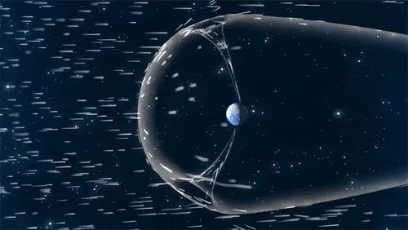
Transient events – weather
CMEs/Solar Flares
Rain
Solar cycle, streams, discontinuities
Credits : NASA

Slide 5
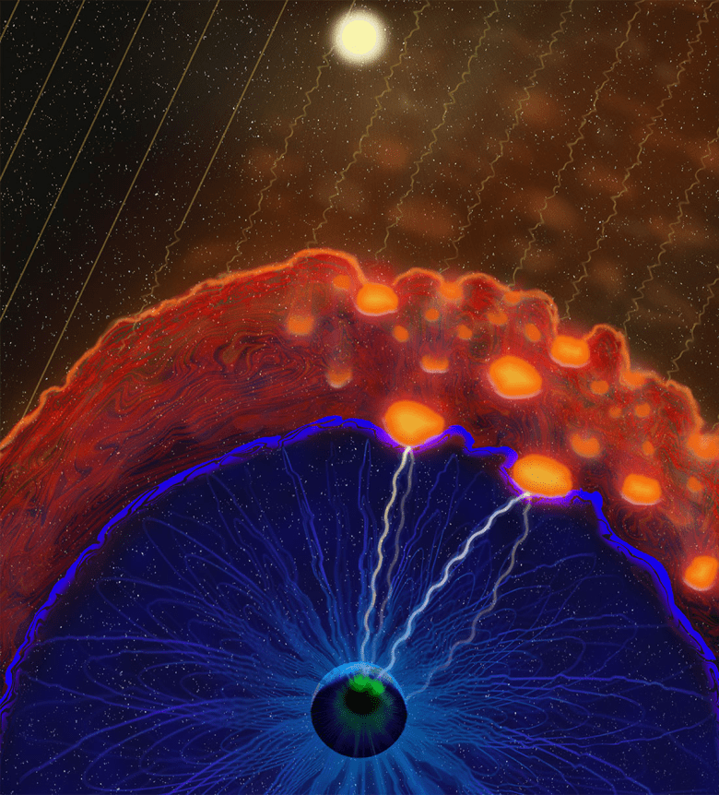
Transient events – space weather
CMEs/Solar Flares
Foreshock structures & plasma jets
Solar cycle, streams, discontinuities
Credits : NASA
Credits: Vuorinen et al. (2022) https://eos.org/features/space-raindrops-splashing-on-earths-magnetic-umbrella

Slide 6
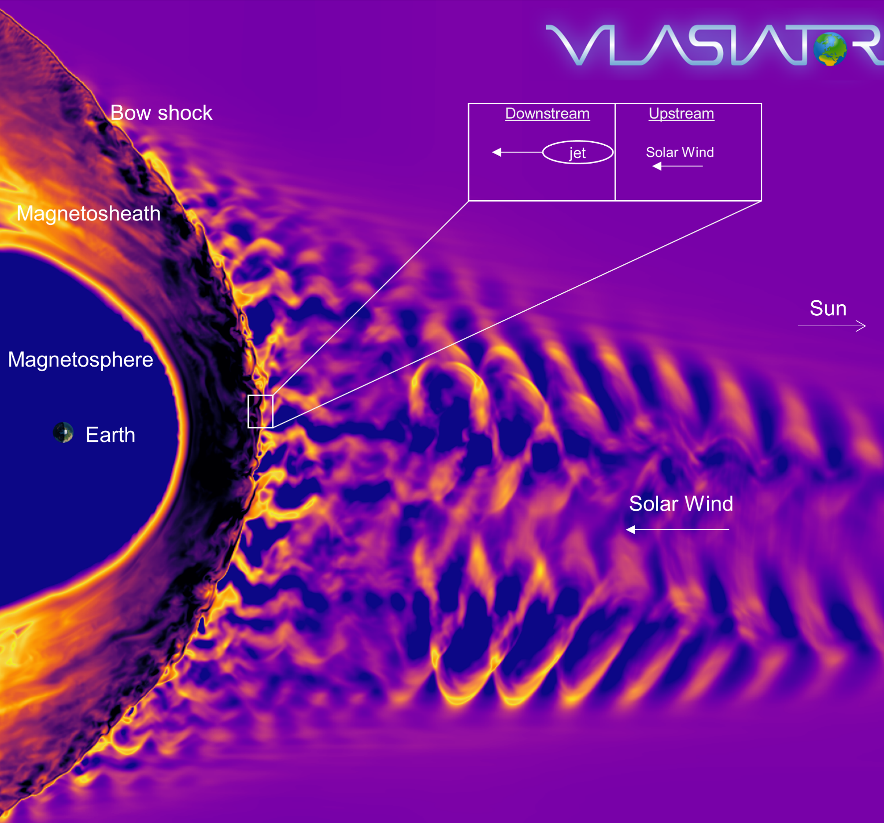
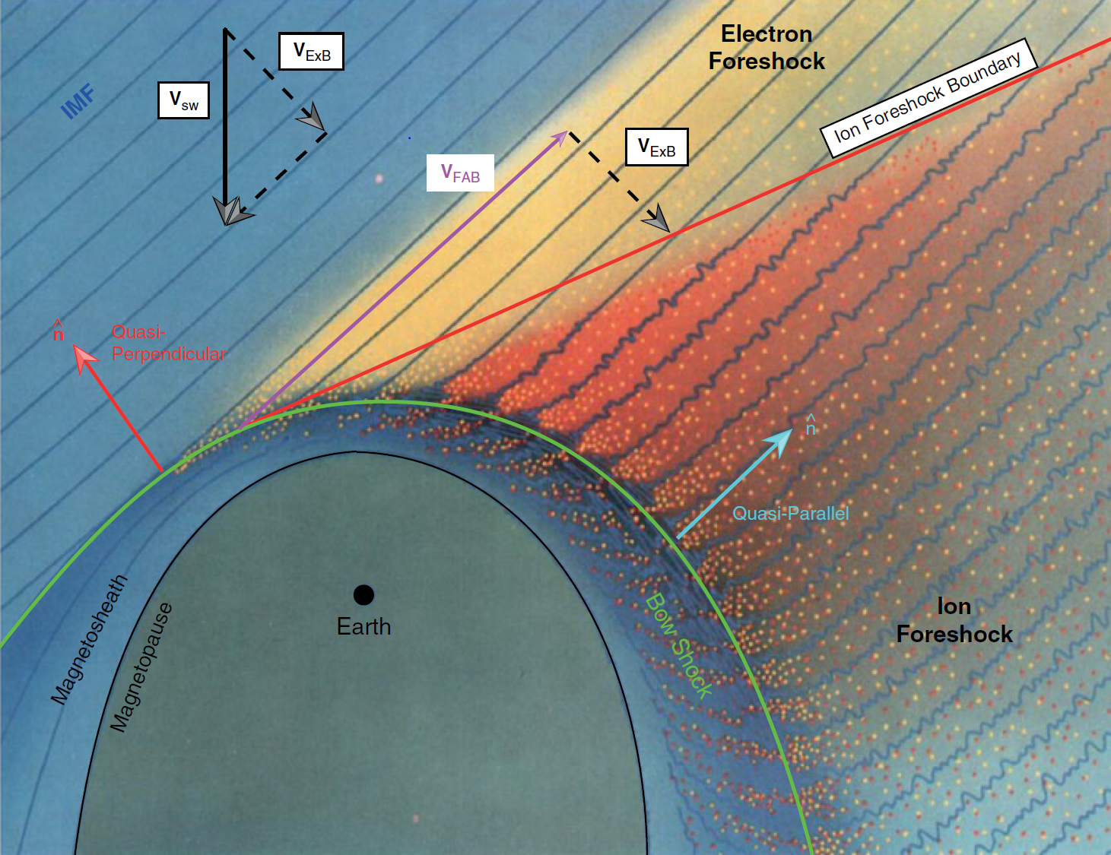
Earth’s magnetosphere & shock environment
Courtesy of M. Palmroth, U Helsinki
L. B. Wilson (2016)

Slide 7
Magnetosheath high-speed jets

Slide 8
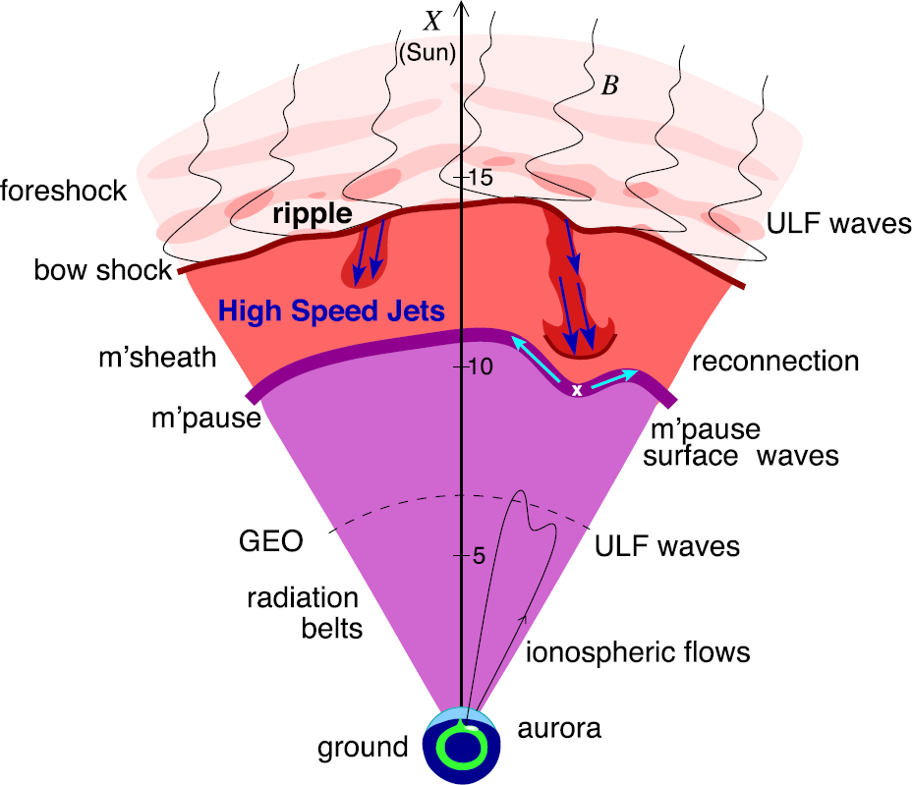
Magnetosheath jets
Definition
Magnetosheath jets are transient localized enhancements of dynamic pressure (density and/or velocity increase)
e.g., 200% dynamic pressure enhancement compared to background magnetosheath
Shock acceleration
Related phenomena
Radiation belts
Throat aurora
Magnetopause reconnection
Magnetopause penetration
Shock acceleration
Magnetopause surface eigenmodes
ULF waves
Substorms
Ground magnetometer detection
Plaschke F. et al. (2018); sketch by H. Hietala | Space Sci. Rev

Slide 9
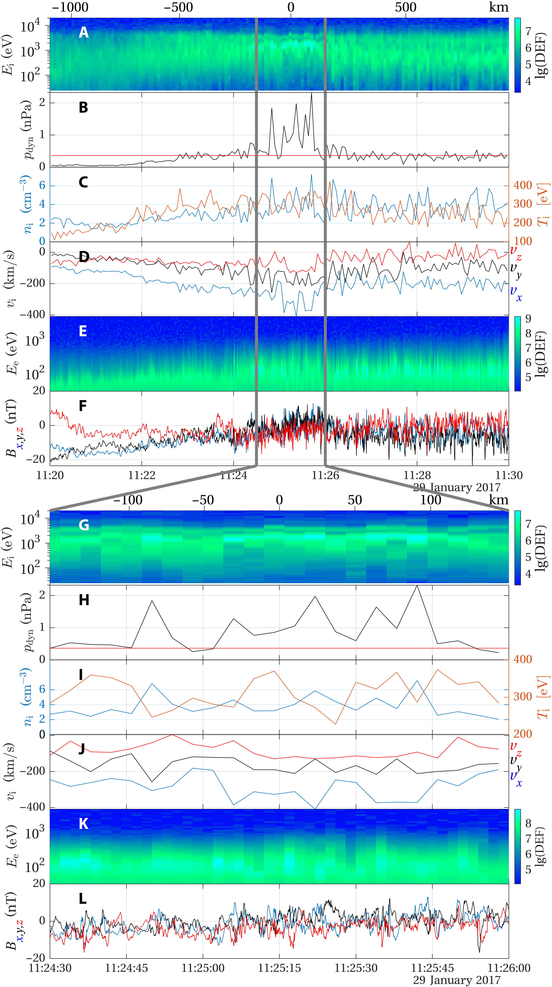
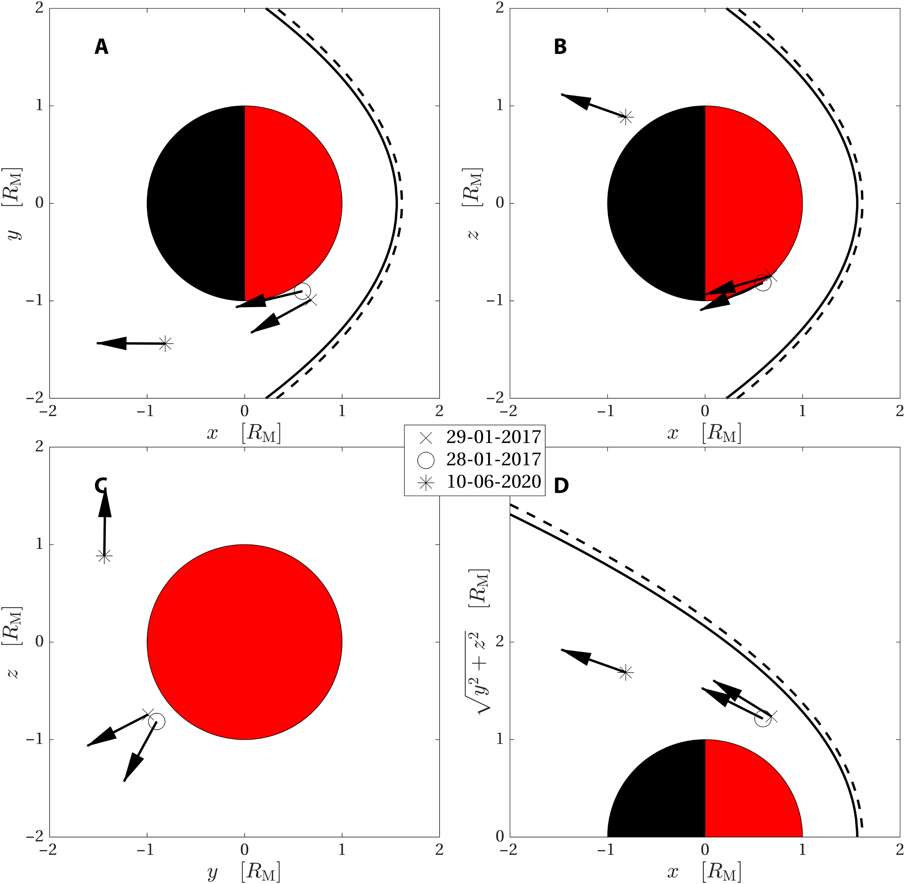
Jets on other planets (Mars - MAVEN)
A jet!
Gunell et al. 2023

Slide 10
Jets – references update (>2019)
Associated phenomena & effects
Excitation of surface eigenmodes at magnetopause: Archer et al. (2019, 2021)
Mirror mode waves and jets: Bianco-Cano et al. (2020)
Bursty magnetic reconnection at the Earth's magnetopause: Ng et al. (2021)
Ground-based magnetometer response: Norenius et al. (2021)
Generation of Pi2 pulsations: Katsavrias et al. (2021)
B in jets, Bz variations near magnetopause: Vuorinen et al. (2021)
High-Speed Jets Triggering Dayside Ground ULF: Wang et al. (2022)
Waves and jets using burst MMS data: Krämer et al. (2023)
Modeling & formation
Velocity & magnetic field alignment in jets: Plaschke et al. (2020)
Classification of jets using MMS & Neural Networks: Raptis et al. (2020a,2020b)
Comparison MMS vs simulations: Palmroth et al. (2021)
Solar wind effect on jet formation: LaMoury et al. (2021)
Magnetosheath Jets and Plasmoids - Hybrid Simulations: Preisser et al. (2020)
Formation of jets in Quasi-perpendicular magnetosheath: Primoz et al. (2021)
Occurrence in relation to CMEs and SIRs: Koller et al. (2022)
Shock reformation and the formation of high-speed jets: Raptis et al. (2022a)
Electron acceleration and bow waves in jets: Vuorinen et al. (2022)
Kinetic structure of jets and partial plasma moments: Raptis et al. (2022b)
Jets Downstream of Collisionless Shocks
Plaschke et al. (2018)
https://link.springer.com/article/10.1007/s11214-018-0516-3
And more : Liu et al. (2020a,2020b), Omelchenko et al (2021), Sibeck et al. (2021), Suni et al. (2021), Tinoco-Arenas et al. (2022) … etc.

Slide 11
Jets – references update (>2019)
Jets Downstream of Collisionless Shocks:
The Last Five Years
Ongoing review (TBD)
Jets Downstream of Collisionless Shocks
Plaschke et al. (2018)
https://link.springer.com/article/10.1007/s11214-018-0516-3

Slide 12
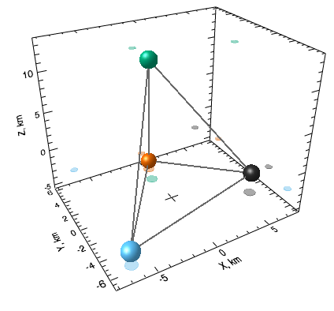
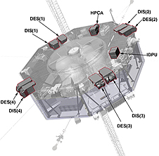
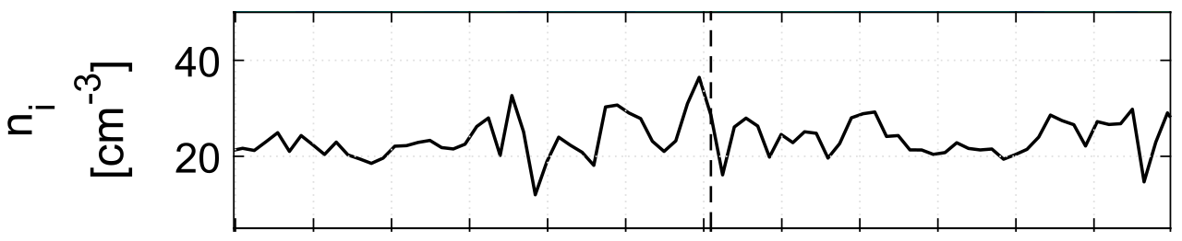
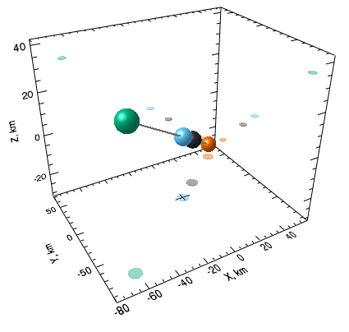
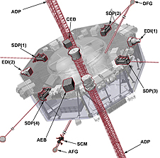
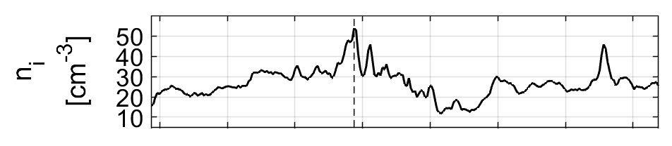
MMS mission & instrumentation
Formation
Instrumentation
Mode
Tetrahedron
String-of-pearls
FPI
FGM
fast/srvy
FPI (ions): 4.5s
FGM: 0.0625s
brst
FPI(ions): 0.15s
FGM: 0.0078s
Notes:
Four dual ion/electron spectrometers
~10 eV – 30 keV
11.25 azimuthial angle
15 polar angle
Fields Suite
Analog fluxgate magnetometer
Digital fluxgate magnetometer
DC – 64Hz
Coil in ferromagnetic metal + current that you reverse = the direction cancel out. So when external field = out of balance = measure difference.
Many of these, you get 3D.
FAST
+ Always available
+ Unbiased
- Low resolution
BRST
+ Very high resolution
- Biased selections

Slide 13
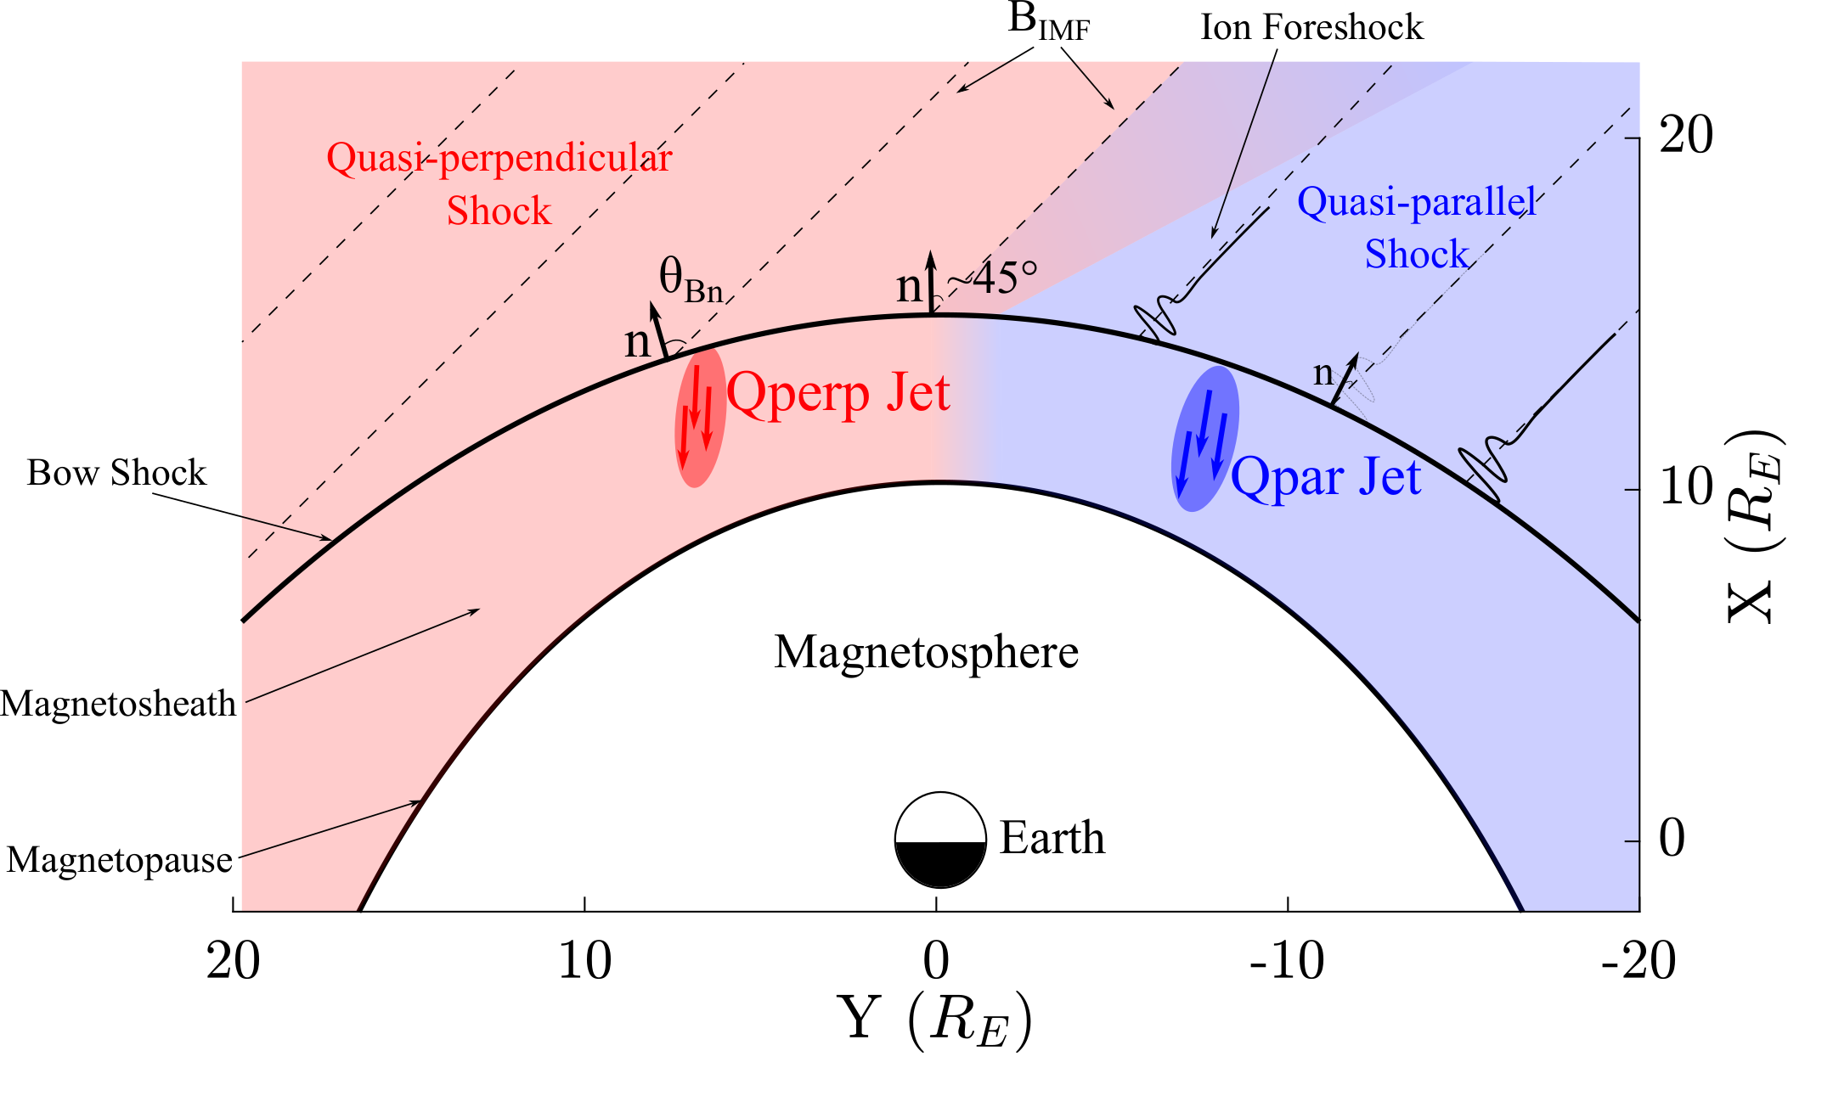
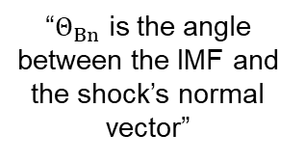
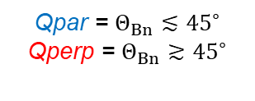
Shock, magnetosheath & jet classification
“$Θ_{Βn}$ is the angle between the IMF and the shock’s normal vector”
Qpar = $Θ_{Βn}≲{45}^{∘}$
Qperp = $Θ_{Βn}≳{45}^{∘}$
Raptis, Aminalragia-Giamini et al. (2020) | Front. Astron. Space Sci
Notes:
”~10 times more often in Qpar MSH”

Slide 14
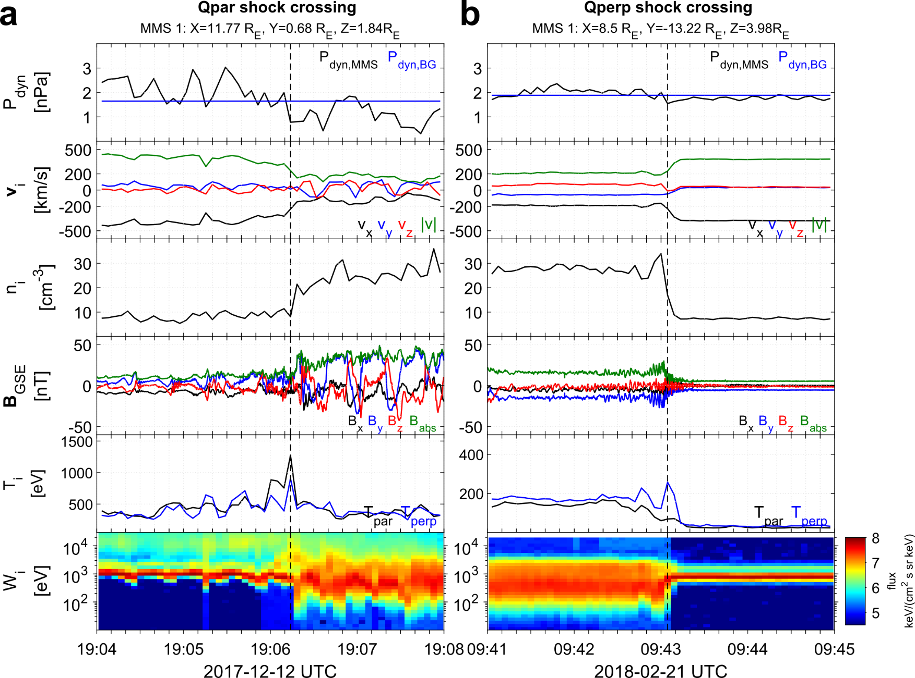
Shock transitions with MMS
SW
MSH
MSH
SW
high-energy ions
Notes:
Magnetic field variance = Foreshock structures
High energy ion flux = foreshock
Temperature anisotropy = particles getting accelerated mainly on

Slide 15
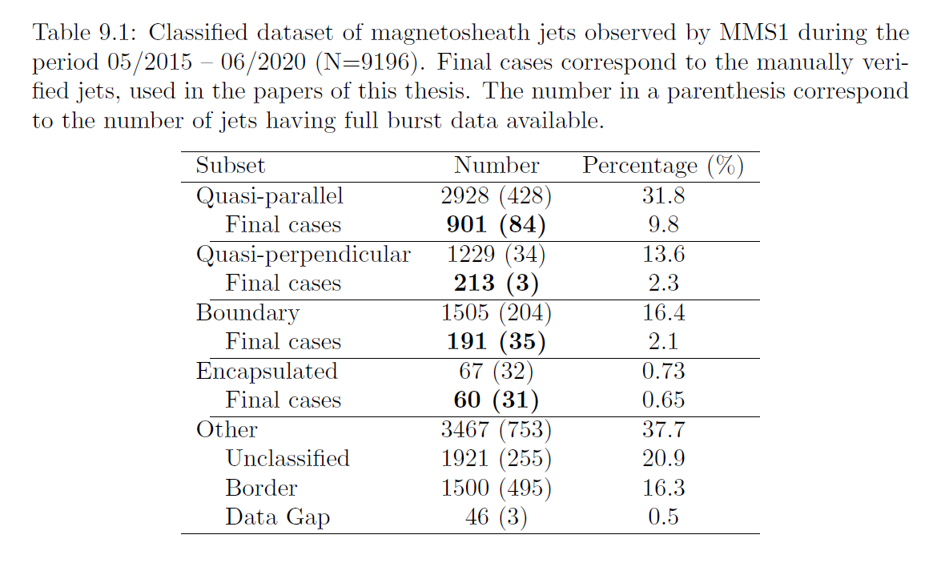
MMS – Updated Jet Database
https://zenodo.org/record/7085778
Thesis: High-speed jets and related phenomena at Earth's bow shock and magnetosheath

Slide 16

Recent MMS results
Formation of Jets
Raptis, S., Karlsson, T., Vaivads, A., Pollock, C., Plaschke, F., Johlander, A., ... & Lindqvist, P. A. (2022). Downstream high-speed plasma jet generation as a direct consequence of shock reformation. Nature communications, 13(1), 598.

Slide 17
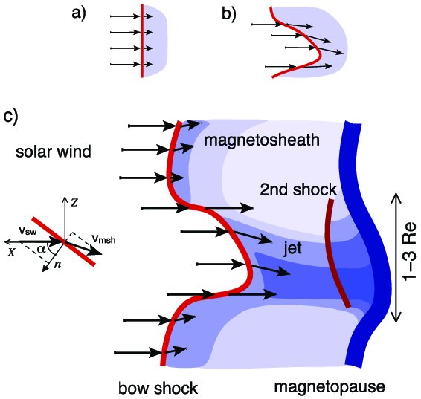
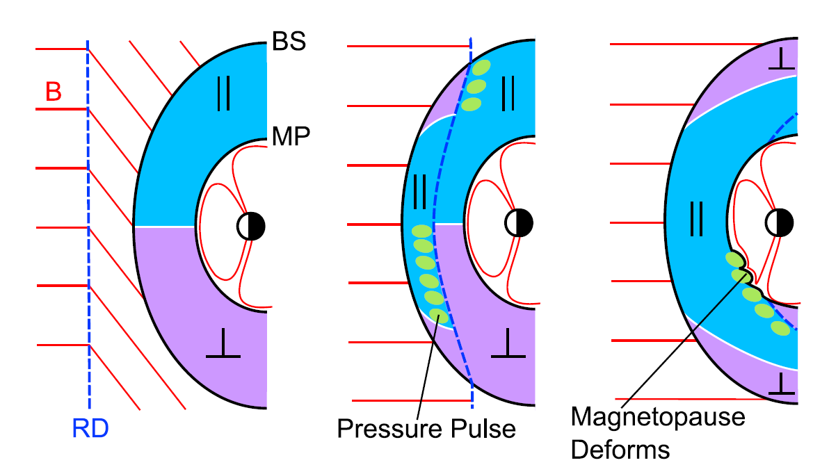
How are these jets created (Qpar) ?
Shock ripples
SW discontinuities
Foreshock Structures & Reformation
SW → locally inclined part of the bow shock → less deceleration and heating
RD → Change in Foreshock position → Pressure pulses
Hietala et al. (2009,2012)
Archer et al. (2012), Zhou et al. (2023)
Karlsson et al.(2015), Suni et al. (2021), Omelchenko et al. (2021), Raptis et al. (2022a)

Slide 18
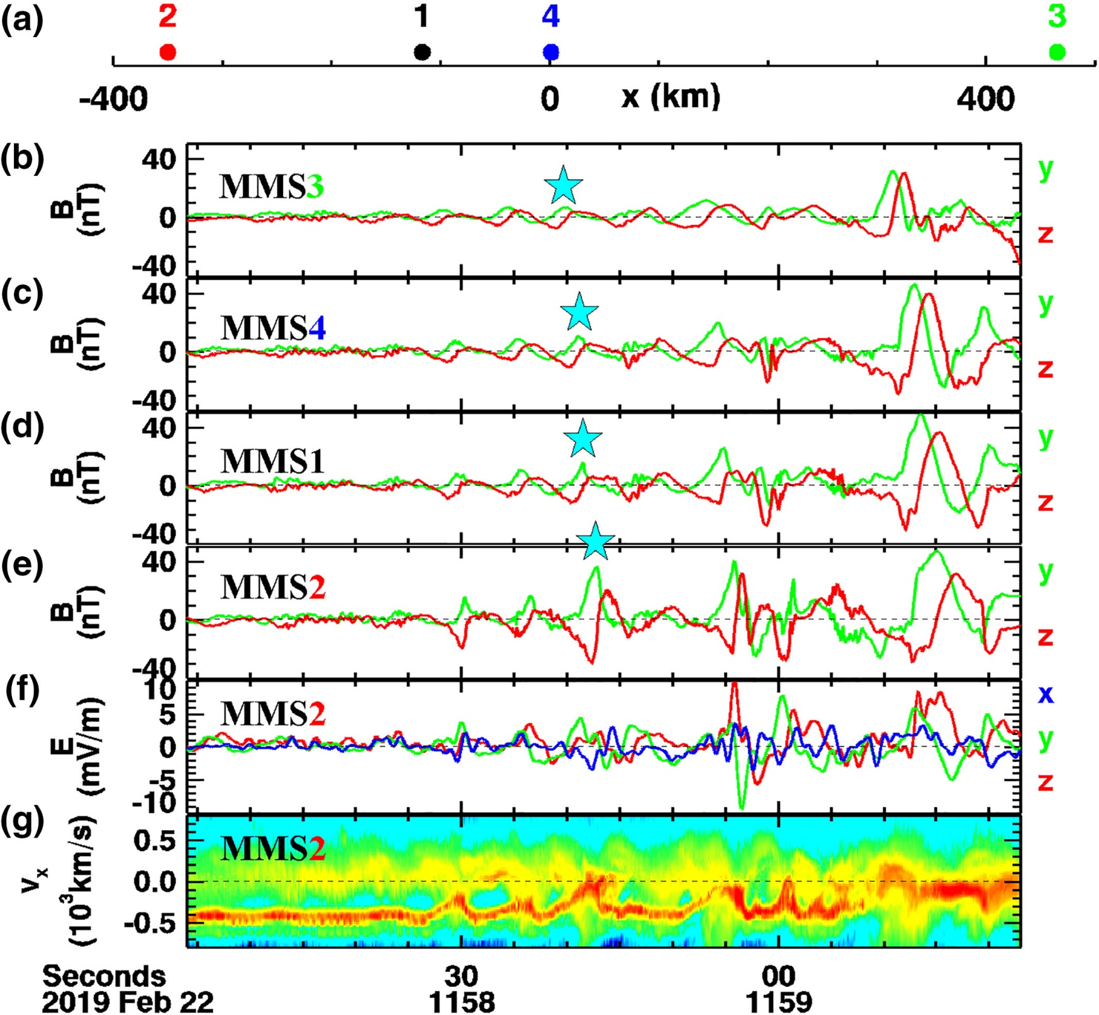
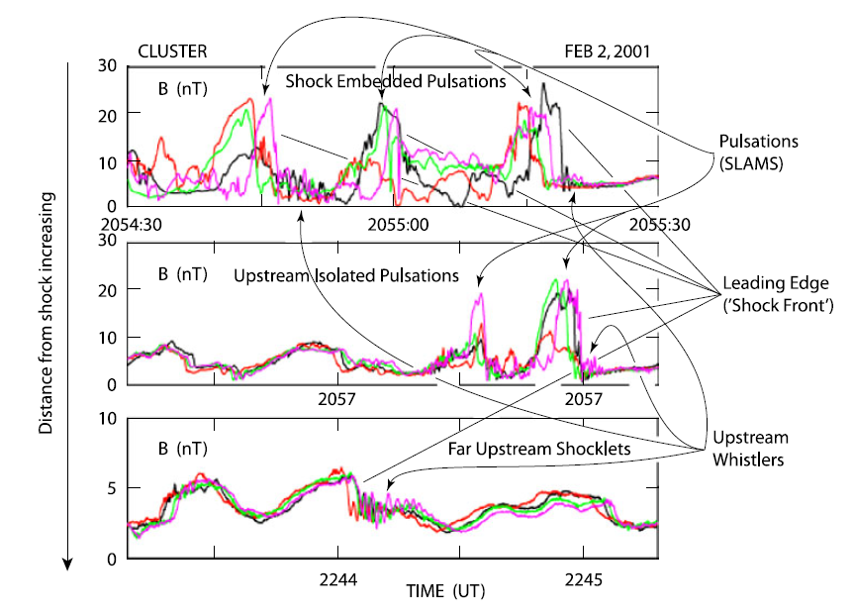
Foreshock & evolution of ULF wavefield
MMS
Cluster
Chen et al. 2021
Lucek et al, 2002

Slide 19
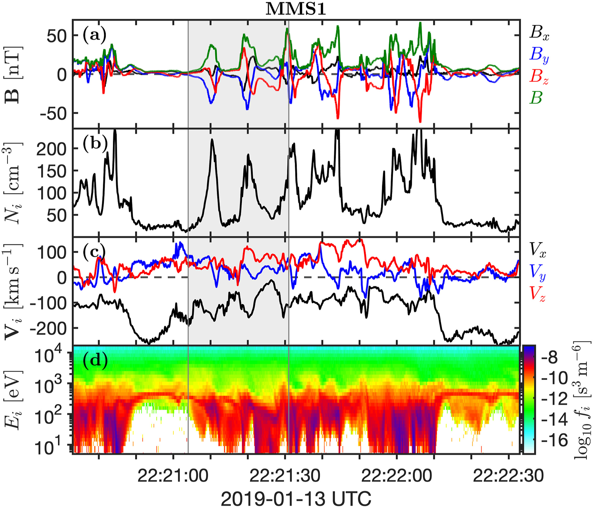
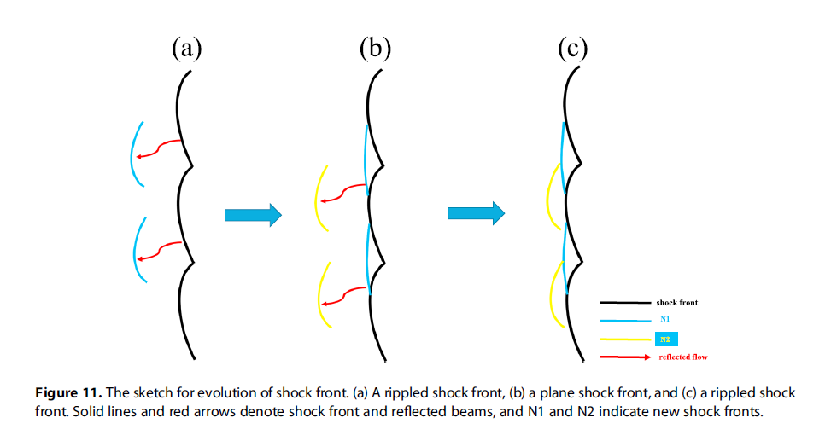
Quasi-parallel shock reformation
Shock Reformation
Burgess (1989): “the shock exhibits a cyclic behavior ….. cyclic shock reformation;”
Hao et al. (2017)
Similar definitions : Hao et al. (2016,2017), Liu et al. (2021), Johlander et al. (2022), Raptis et al. (2022a)
Johlander et al. (2022)
Notes:
Average ~20 seconds

Slide 20
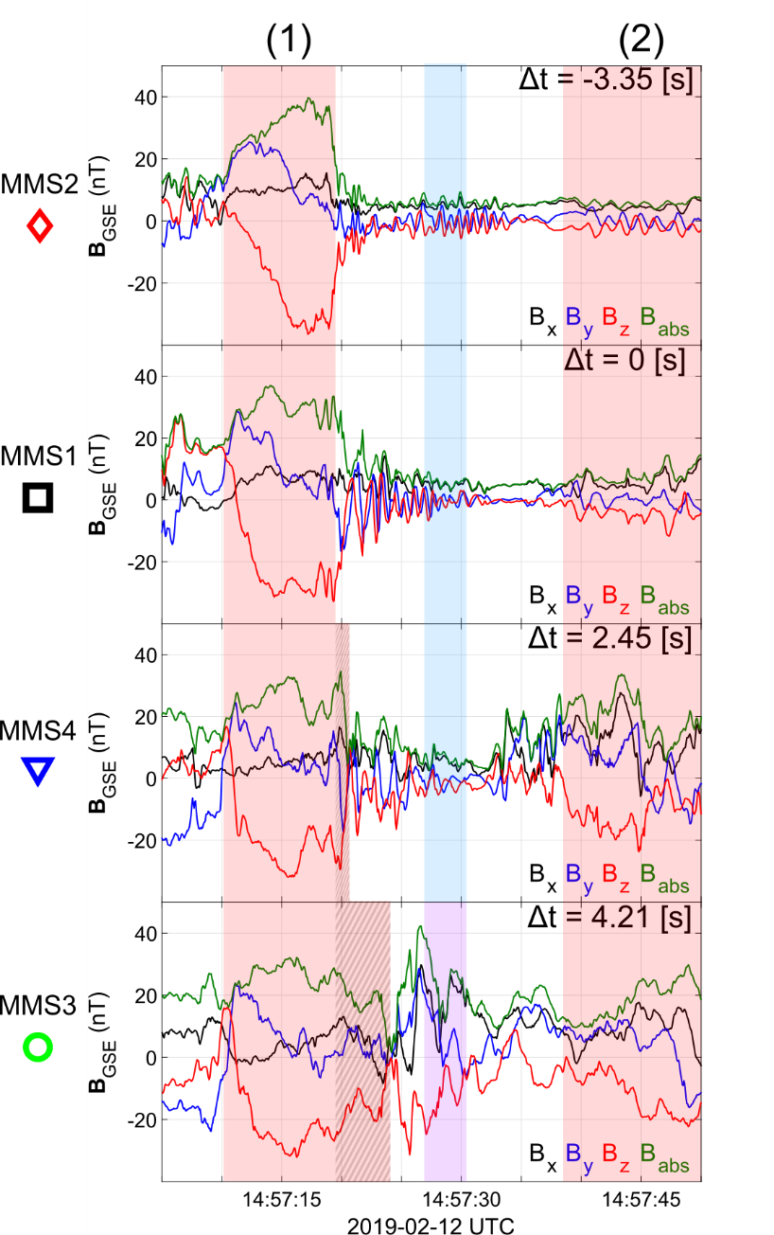
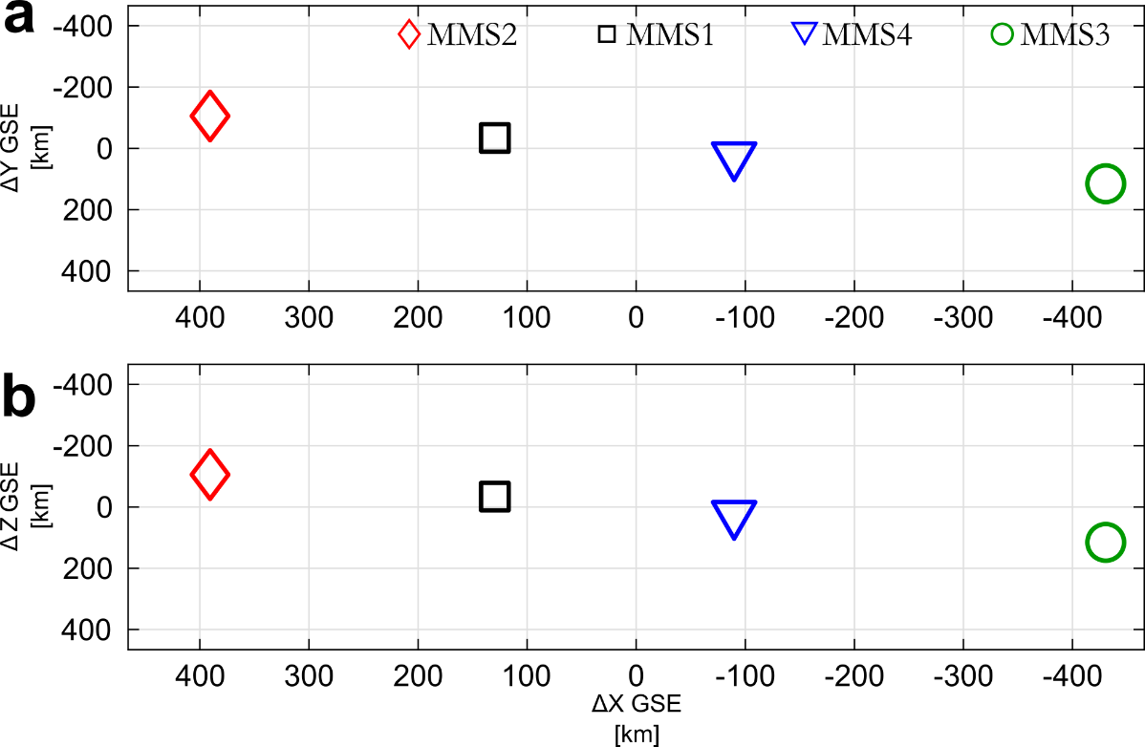
SLAMS – wave activity and reformation
Sun
Earth
Evolution of SLAMS
Interaction with upstream whistler
New peak /evolution*
Formation of downstream density enhancement**
* See similar examples by Turner et al. (2021), Chen et al. (2021) | “(Self-) reformation/evolution”
** See similar example by Liu et al. (2021), Johlander et al. (2022) | (Qpar) reformation

Slide 21
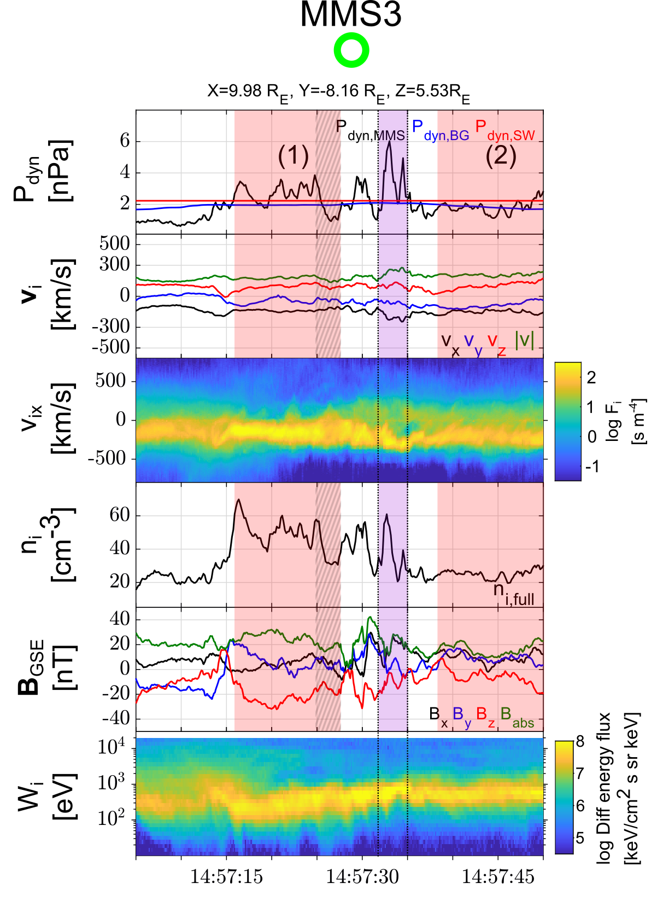
Jet “slipping through” the reformation cycle
Sun
Earth
Properties
Thermalized distribution
Compression
Dynamic pressure increase (i.e., increase in velocity and density)
Raptis S., et al. 2022a | Nat. Commun.

Slide 22
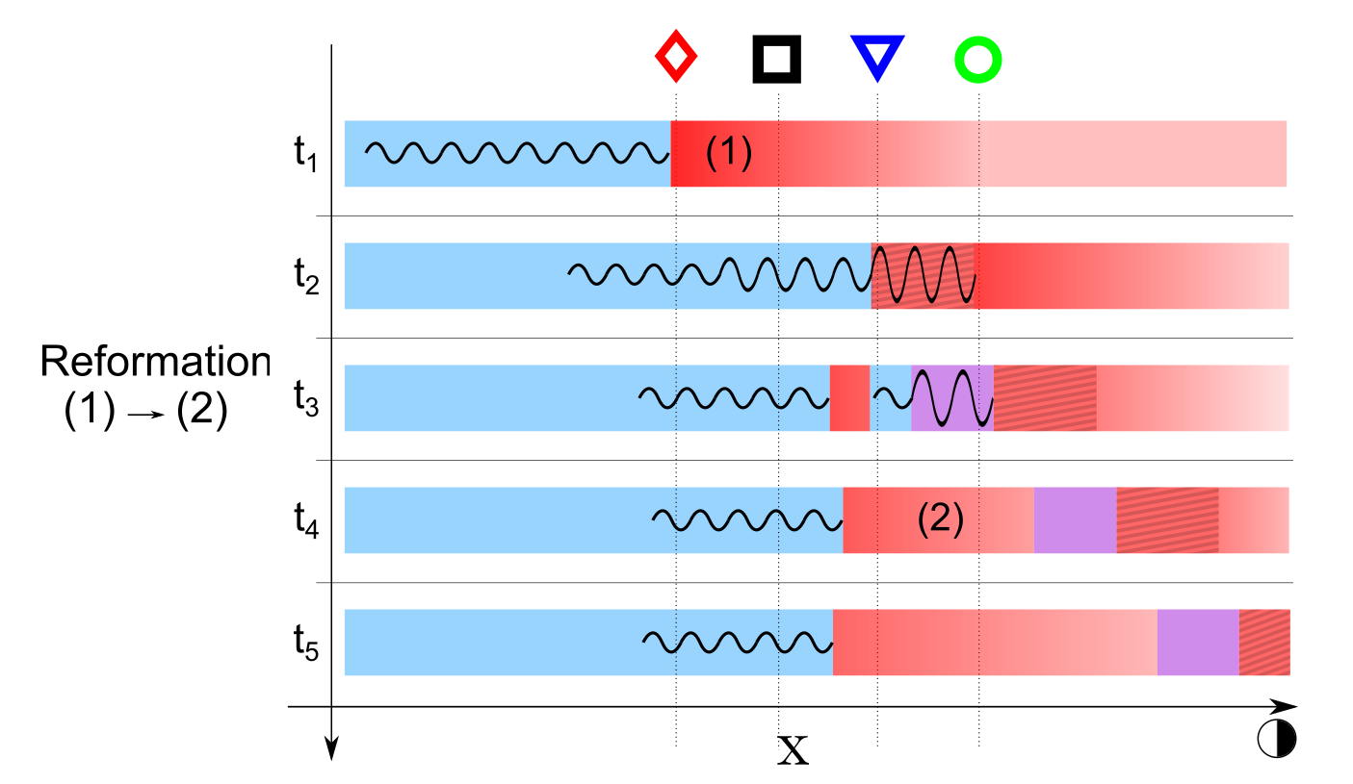
Shock reformation & magnetosheath jets
Raptis S., et al. 2022a | Nat. Commun.

Slide 23
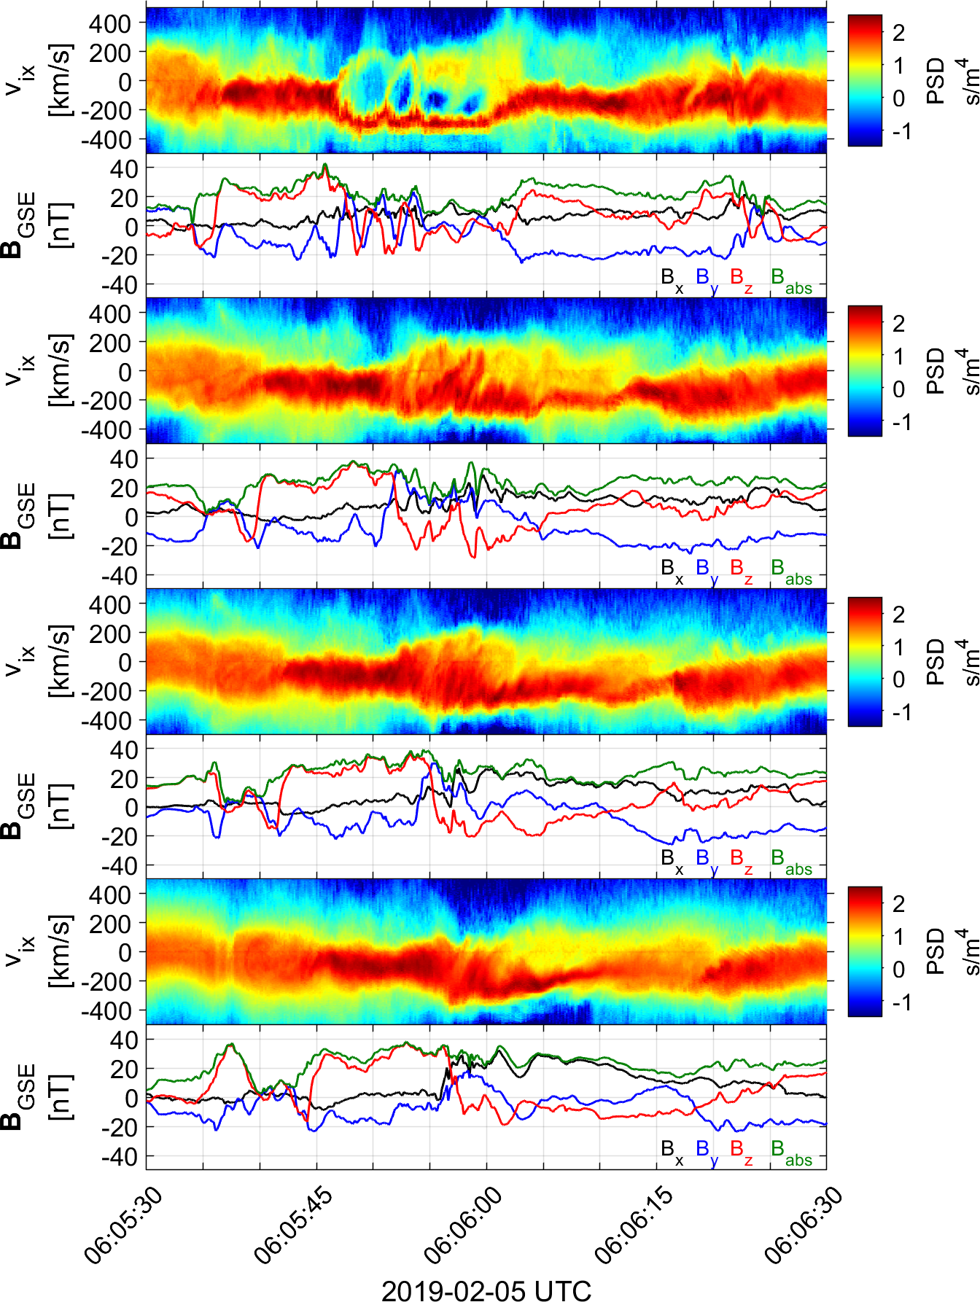
More events ( MMS 1 – 4)
Evolution of foreshock structure upstream to downstream
Sun
Earth
Raptis+ 2023 (Ongoing)
+Very promising comparison results with VLASIATOR Hybrid simulations (soon….)

Slide 24
More events ( MMS 1 – 4)
Jet forming from the upstream wave field & the reformation
Sun
Earth
Raptis+ 2023 (Ongoing)
+Very promising comparison results with VLASIATOR Hybrid simulations (soon….)

Slide 25
More events ( MMS 1 – 4)
Sun
Earth
Raptis+ 2023 (Ongoing)
+Promising comparison results with VLASIATOR Hybrid simulations….

Slide 26
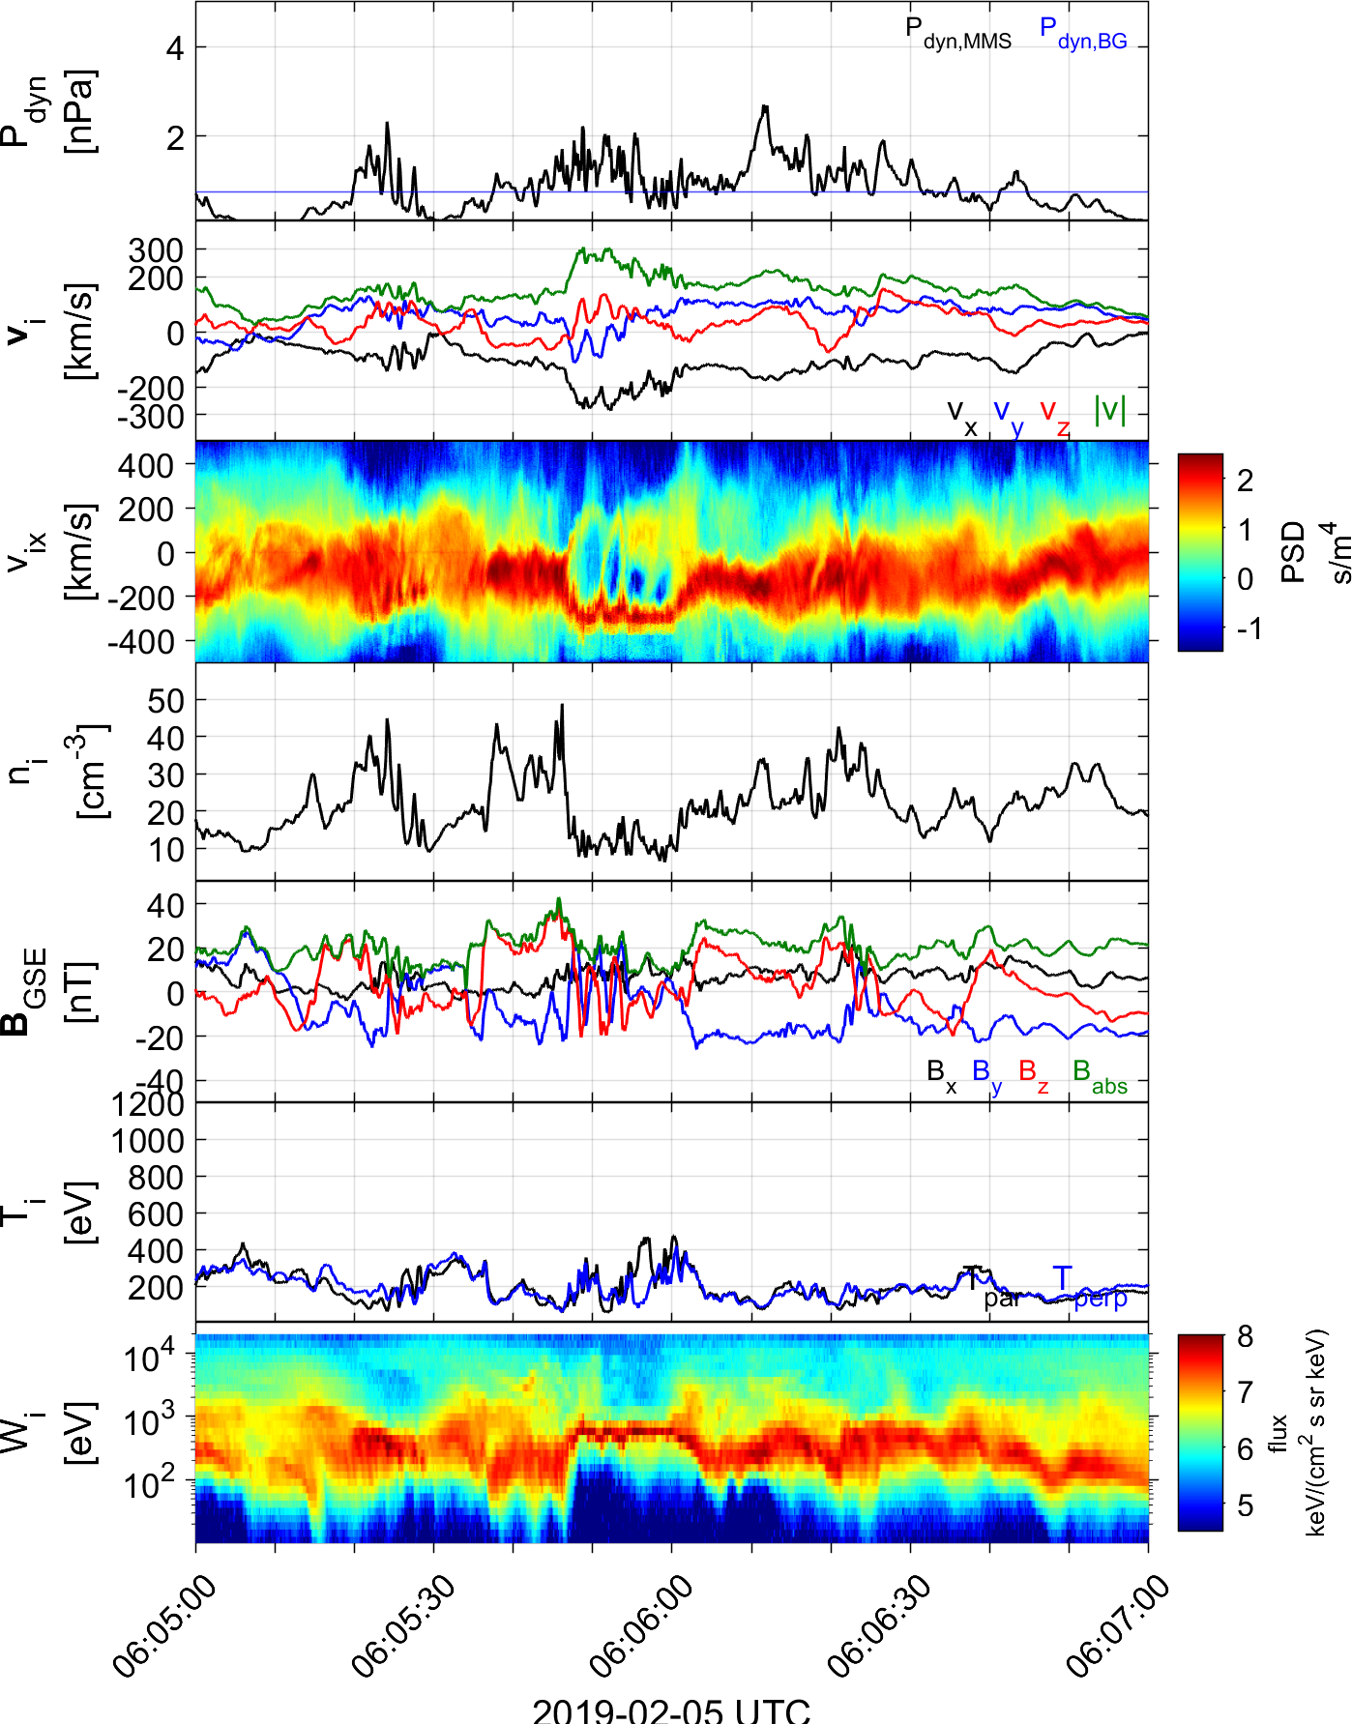
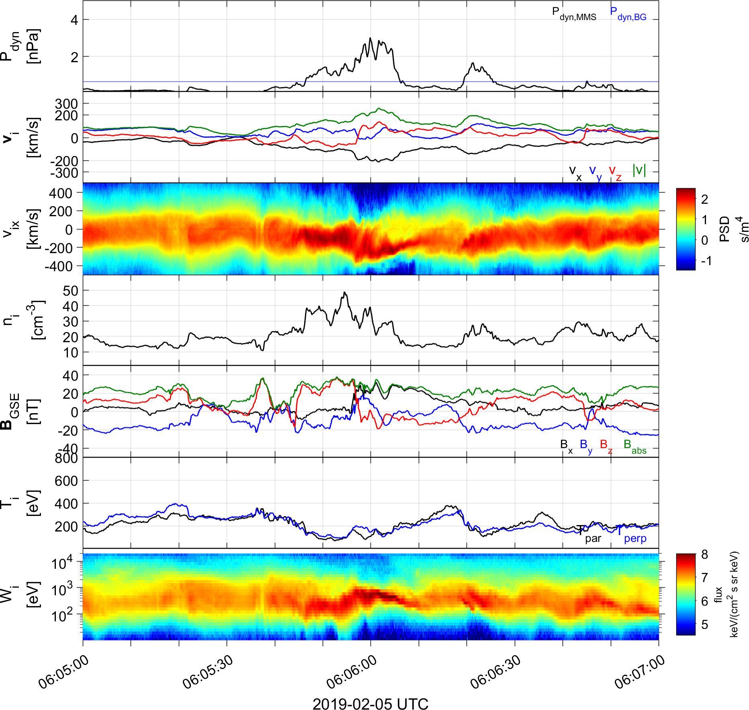
More events ( MMS 2 & 3)
Upstream
Downstream
Raptis+ 2023 (Ongoing)
+Promising comparison results with VLASIATOR Hybrid simulations….

Slide 27

Recent MMS results
Evolution & Properties of Jets
Raptis, S., Karlsson, T., Vaivads, A., Lindberg, M., Johlander, A., & Trollvik, H. (2022). On magnetosheath jet kinetic structure and plasma properties. Geophysical Research Letters, 49(21), e2022GL100678.

Slide 28
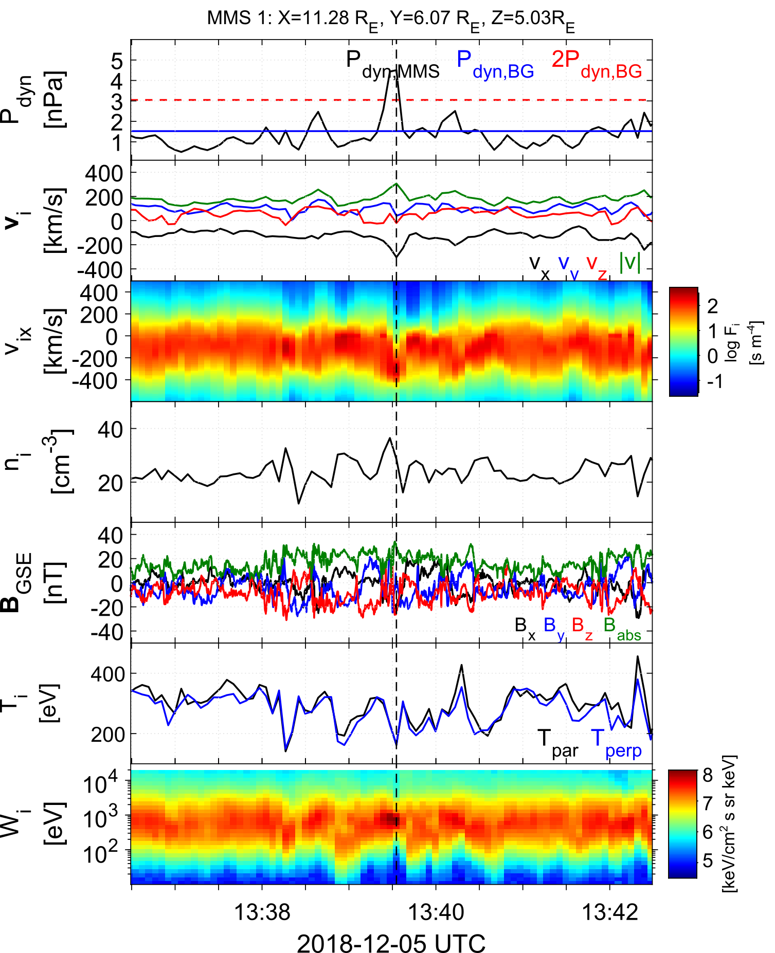
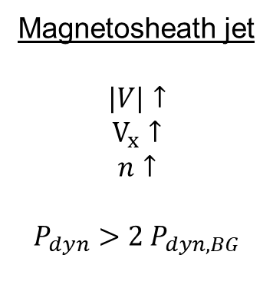
Qpar magnetosheath jet – fast data
Qpar magnetosheath:
High energy ions
Low temperature anisotropy
High B Variance
Magnetosheath jet
$$|V|↑$$
$$V_{x}↑$$
$$n↑$$
$$P_{dyn}>2 P_{dyn,BG}$$
Raptis S, et al,. 2022b | GRL

Slide 29
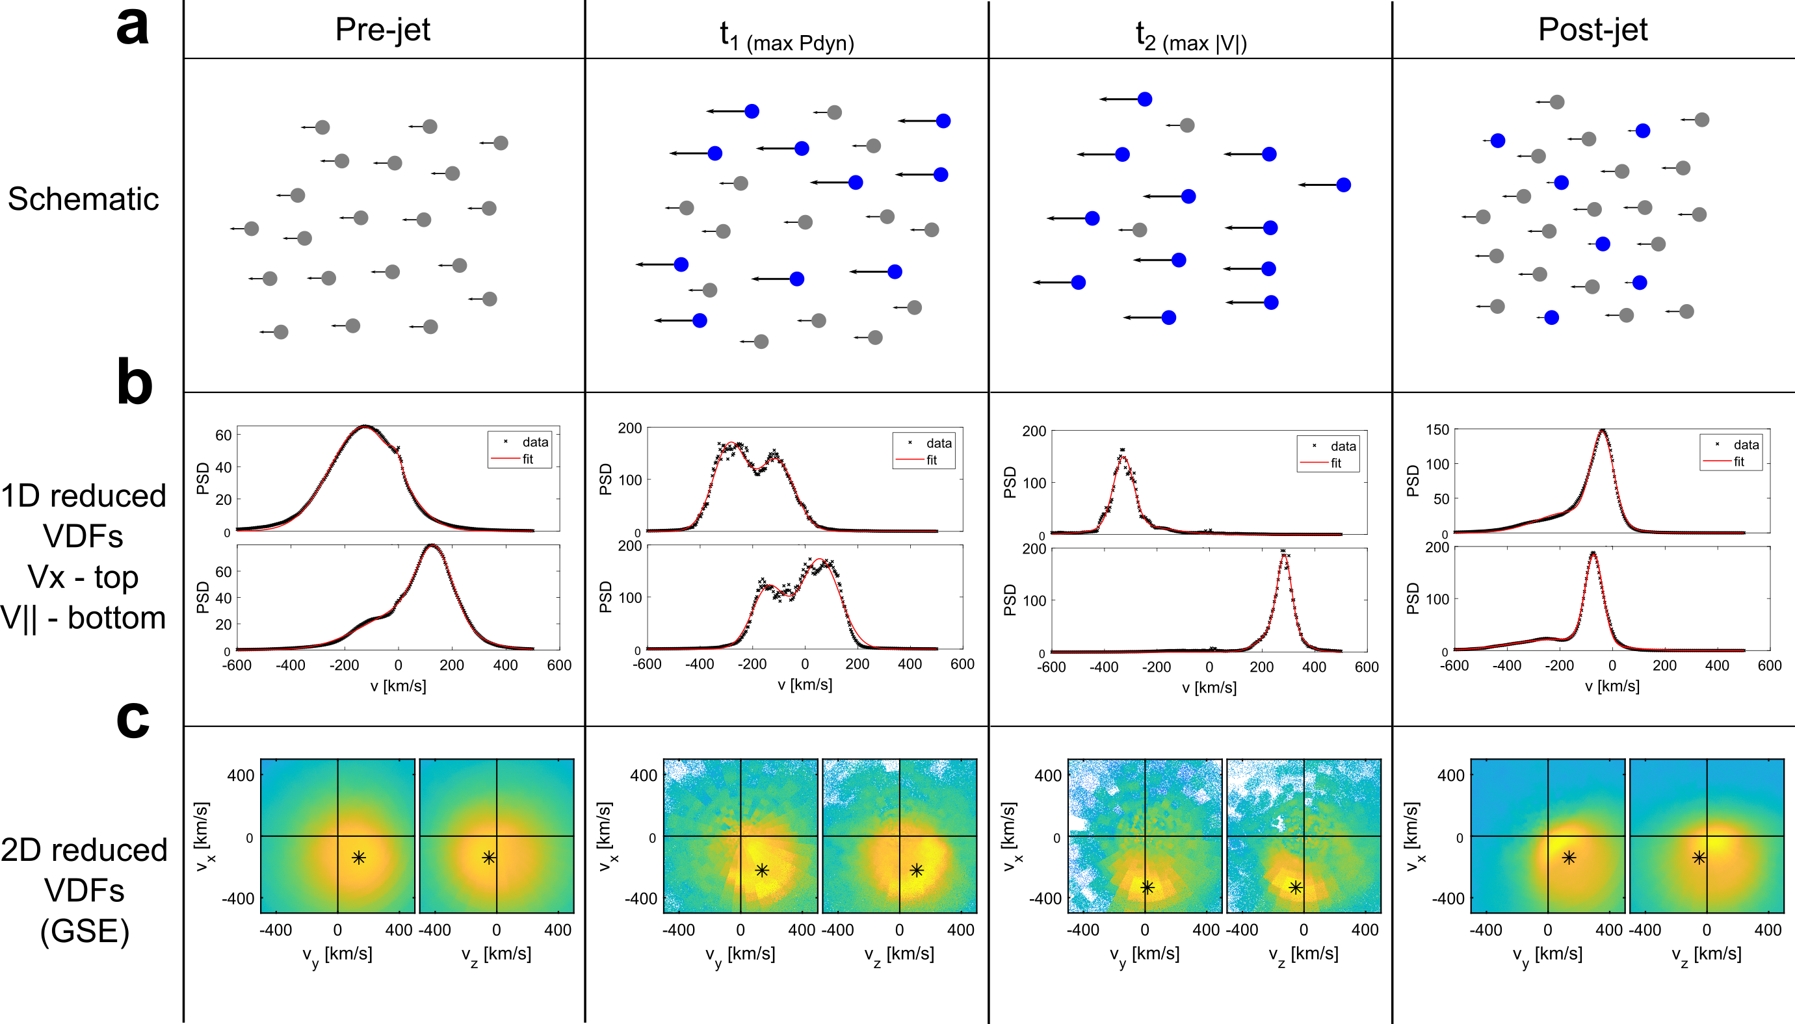
Jet evolution in Qpar magnetosheath
Raptis S, et al,. 2022b | GRL

Slide 30
Jet evolution in Qpar magnetosheath
Raptis S, et al,. 2022b | GRL

Slide 31
Jet evolution in Qpar magnetosheath
Raptis S, et al,. 2022b | GRL

Slide 32
Summary & Future

Slide 33
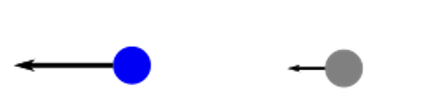
Summary
Jets forming from shock’s fundamental non-stationarity
Jets exhibiting 2+ populations = Partial moments needed
= Very similar to upstream SW
Jet
BG/MSH
Shocks, magnetosheath, fast plasma flows, foreshock transients etc. = kinetic structures

Slide 34
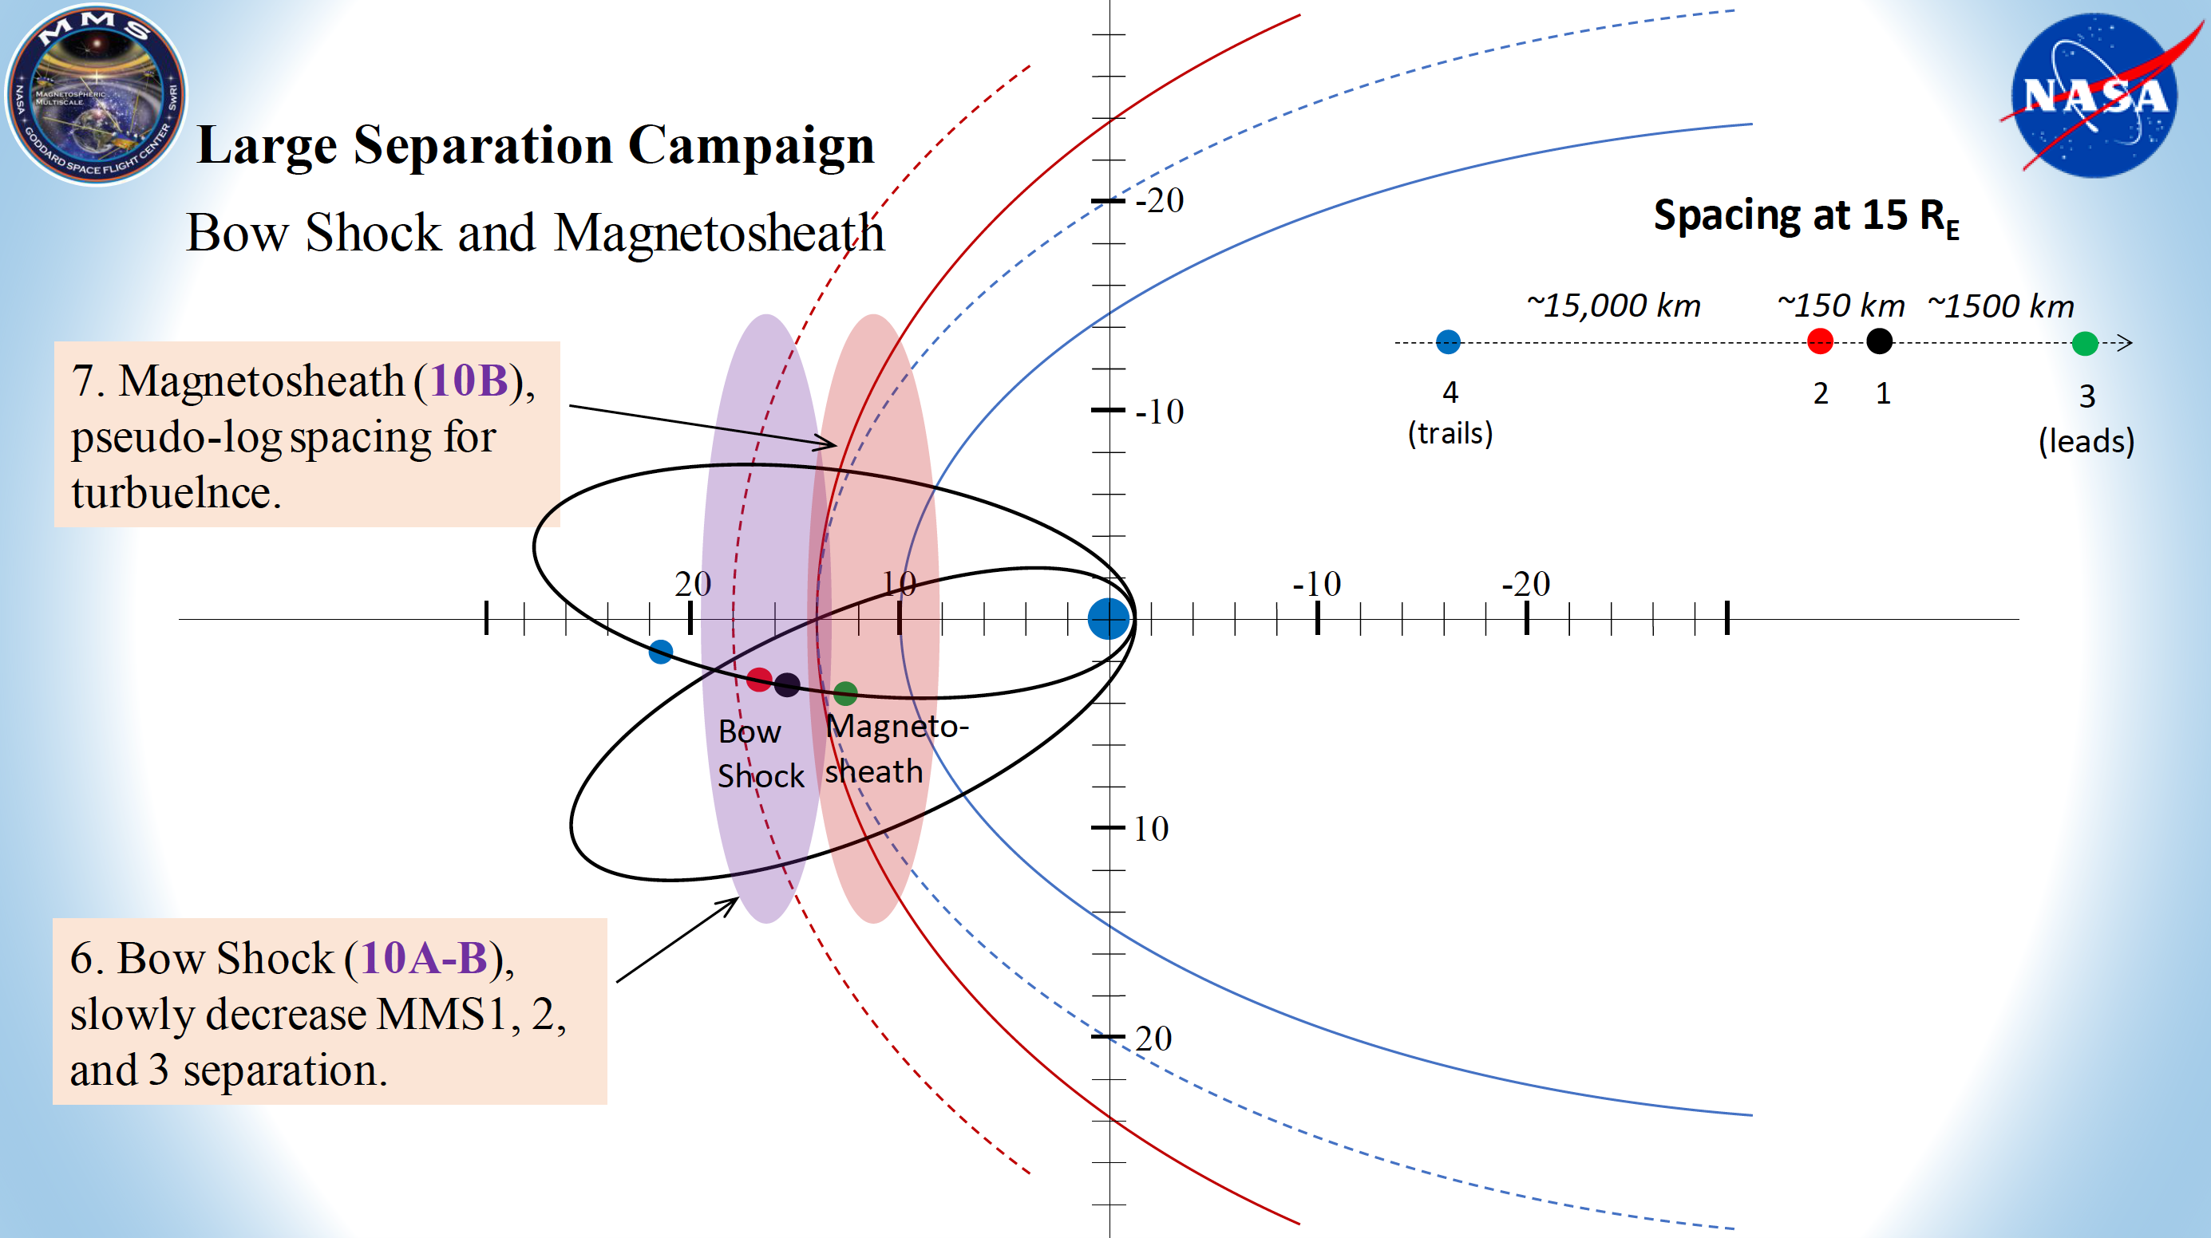
Future – MMS

Slide 35

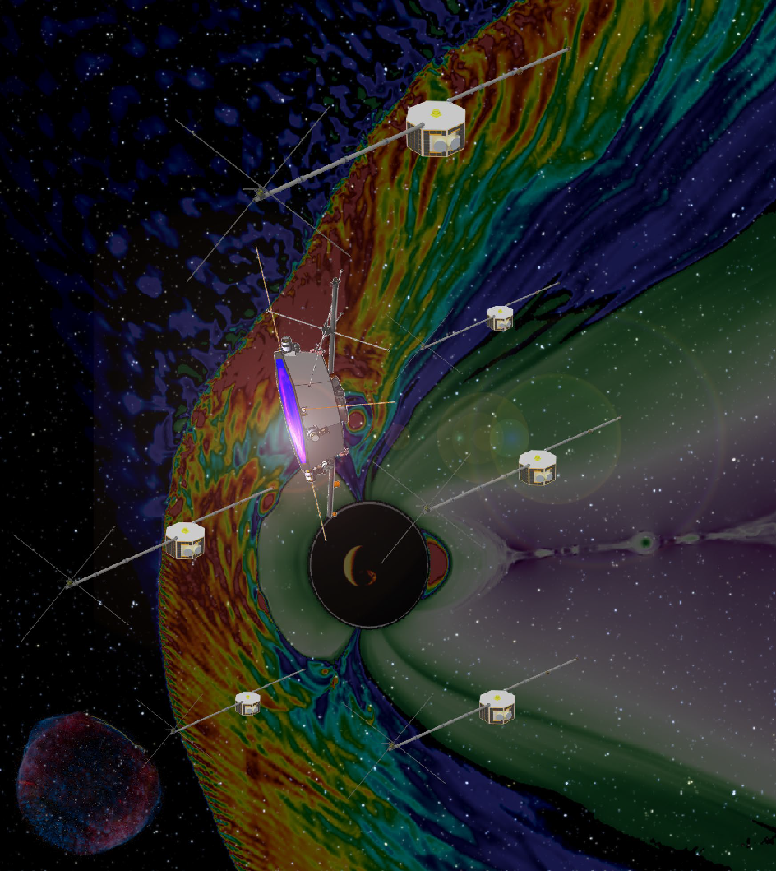


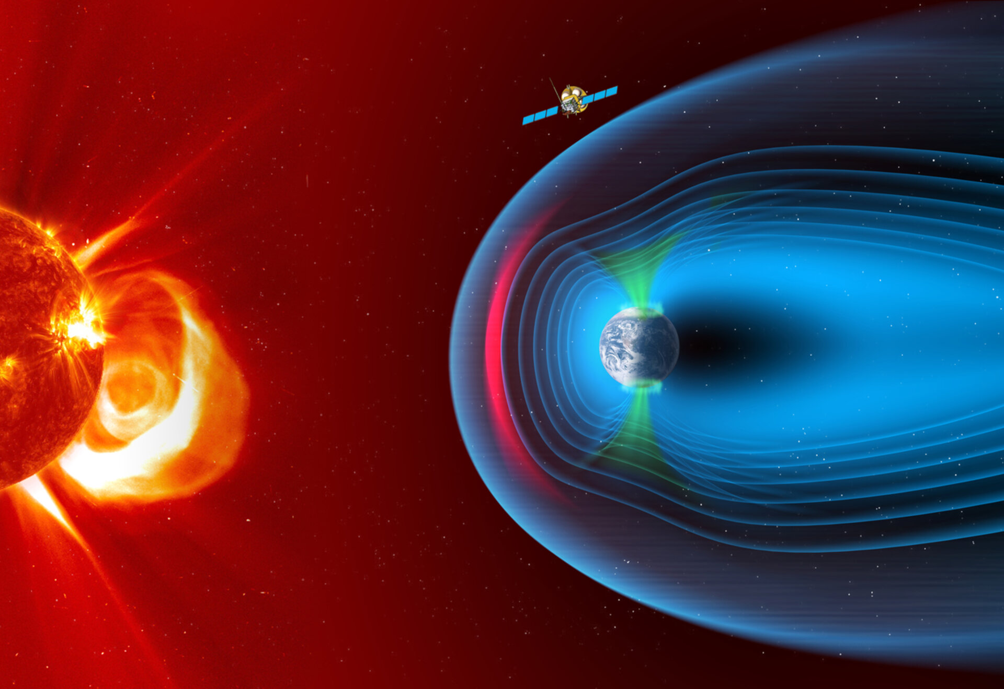


Future – Data & Simulations
Plasma Observatory
9 spacecraft
50 - 3,000 km
5-7 spacecraft
30 - 5,000 km
Menura

Slide 36
Extras

Slide 37

Proposing a new model
*
*
*
*
*Where, standards = models, mechanisms, explanations etc.

Slide 38
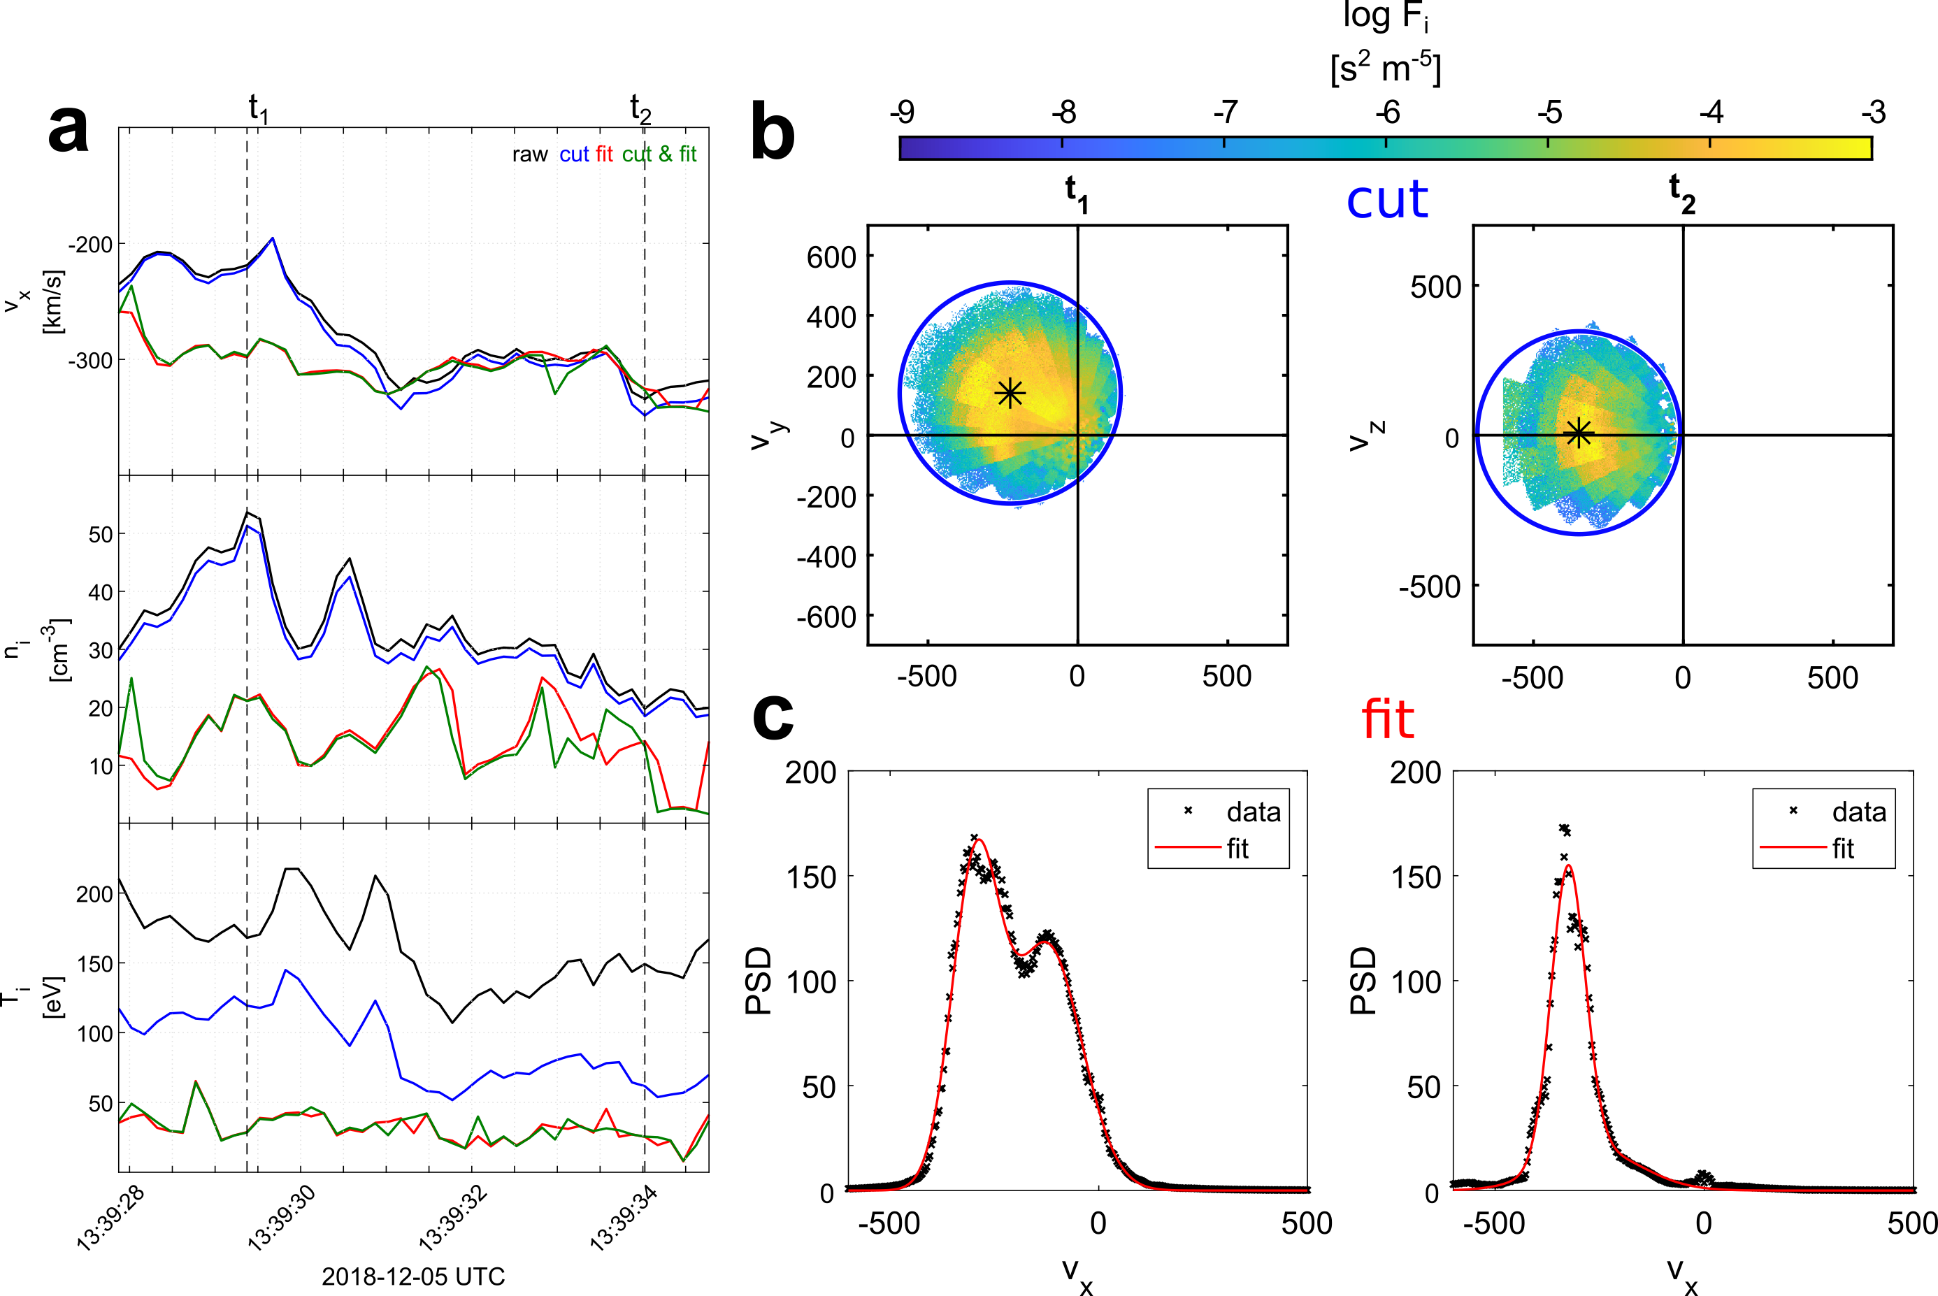
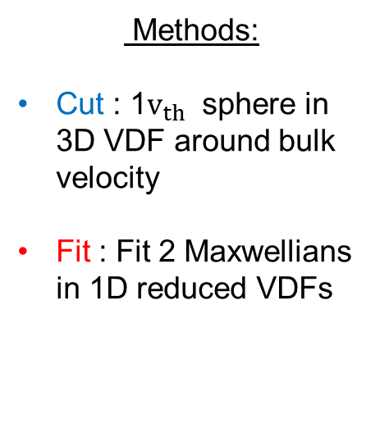
Partial Moment Derivation
Methods:
Cut : 1$v_{th}$ sphere in 3D VDF around bulk velocity
Fit : Fit 2 Maxwellians in 1D reduced VDFs
Raptis S, et al,. 2022b | GRL

Slide 39
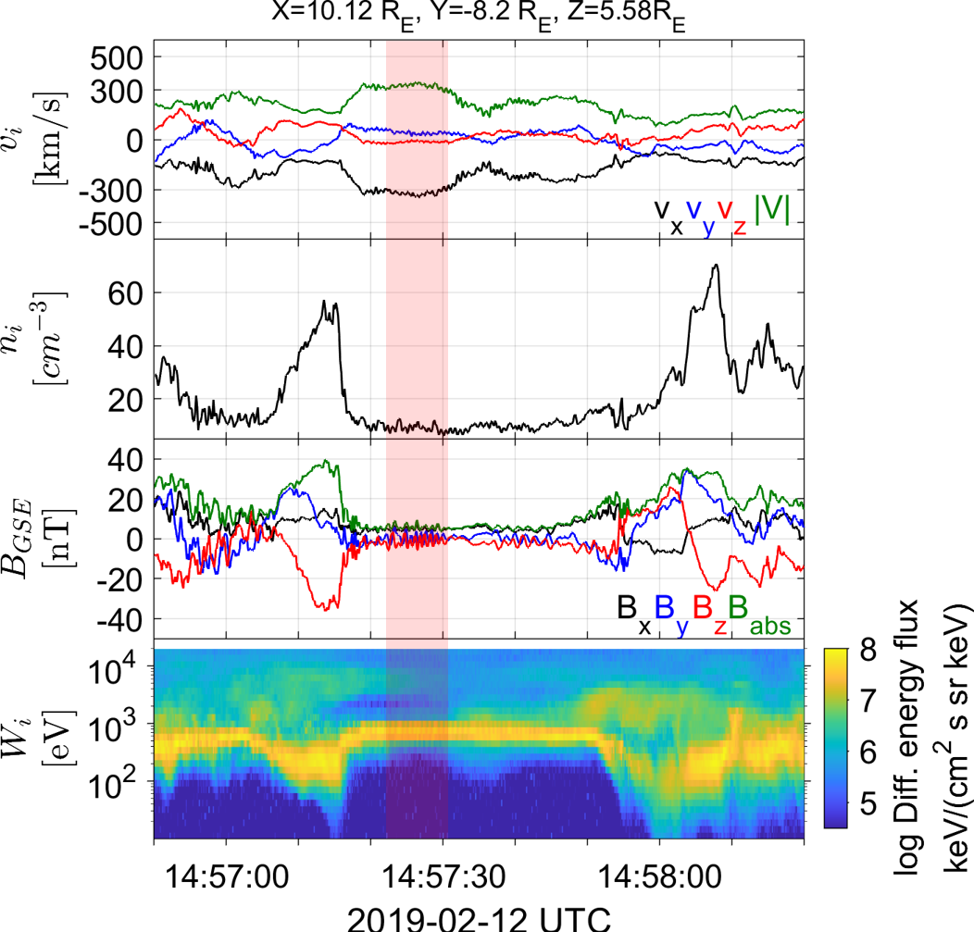
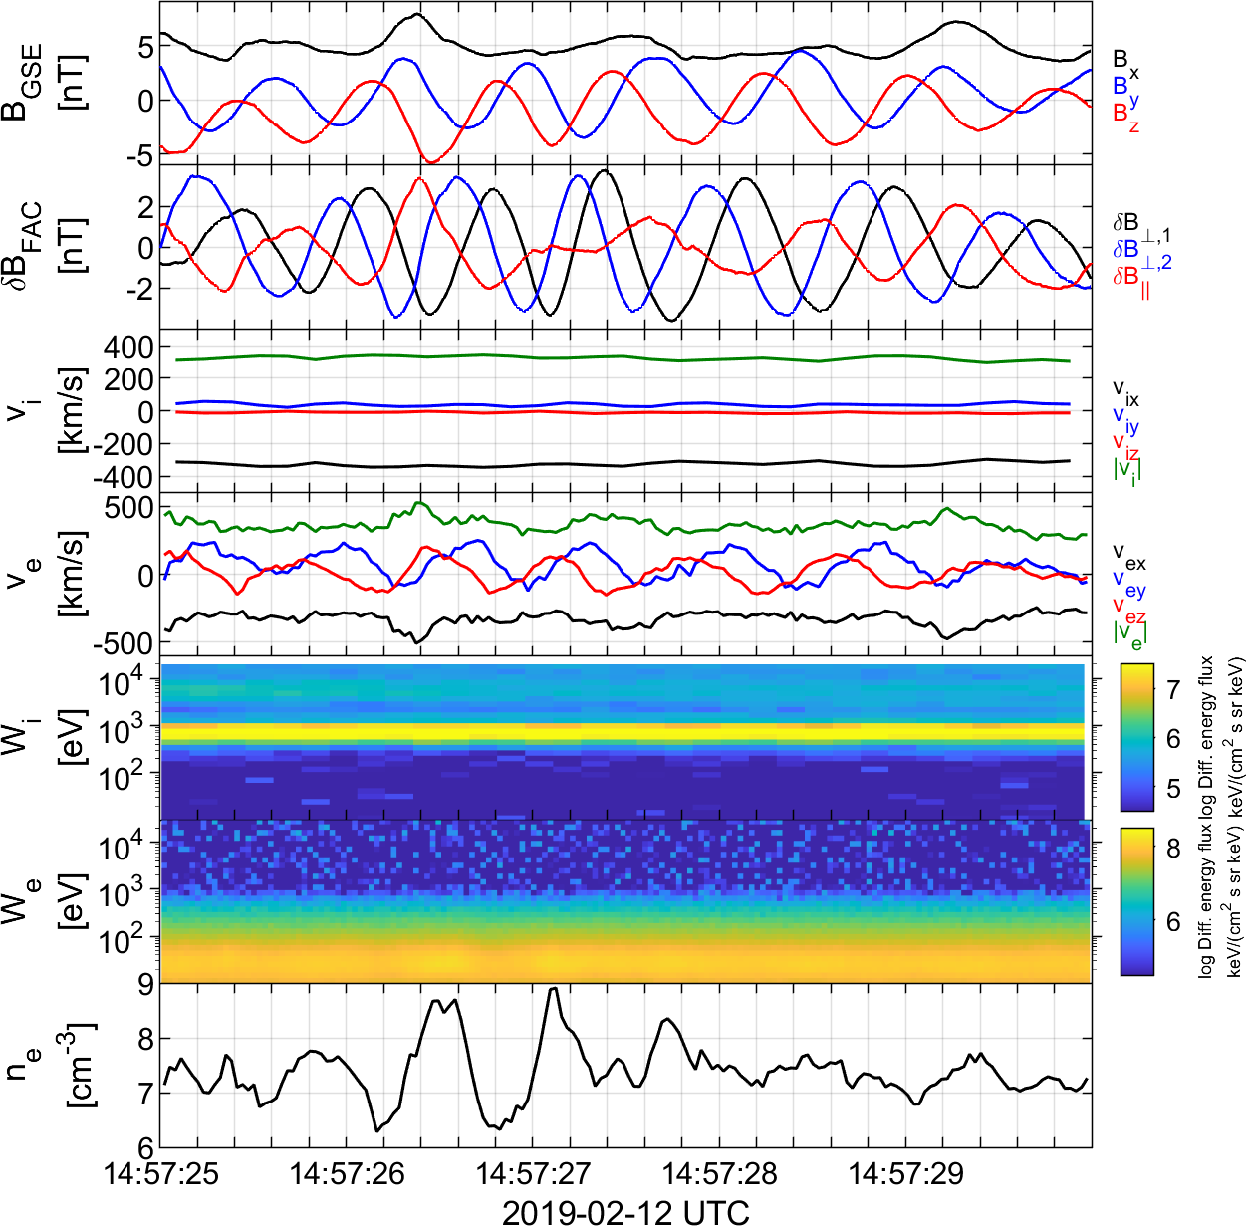
Upstream whistlers associated to reformation
Unpublished data - ongoing

Slide 40
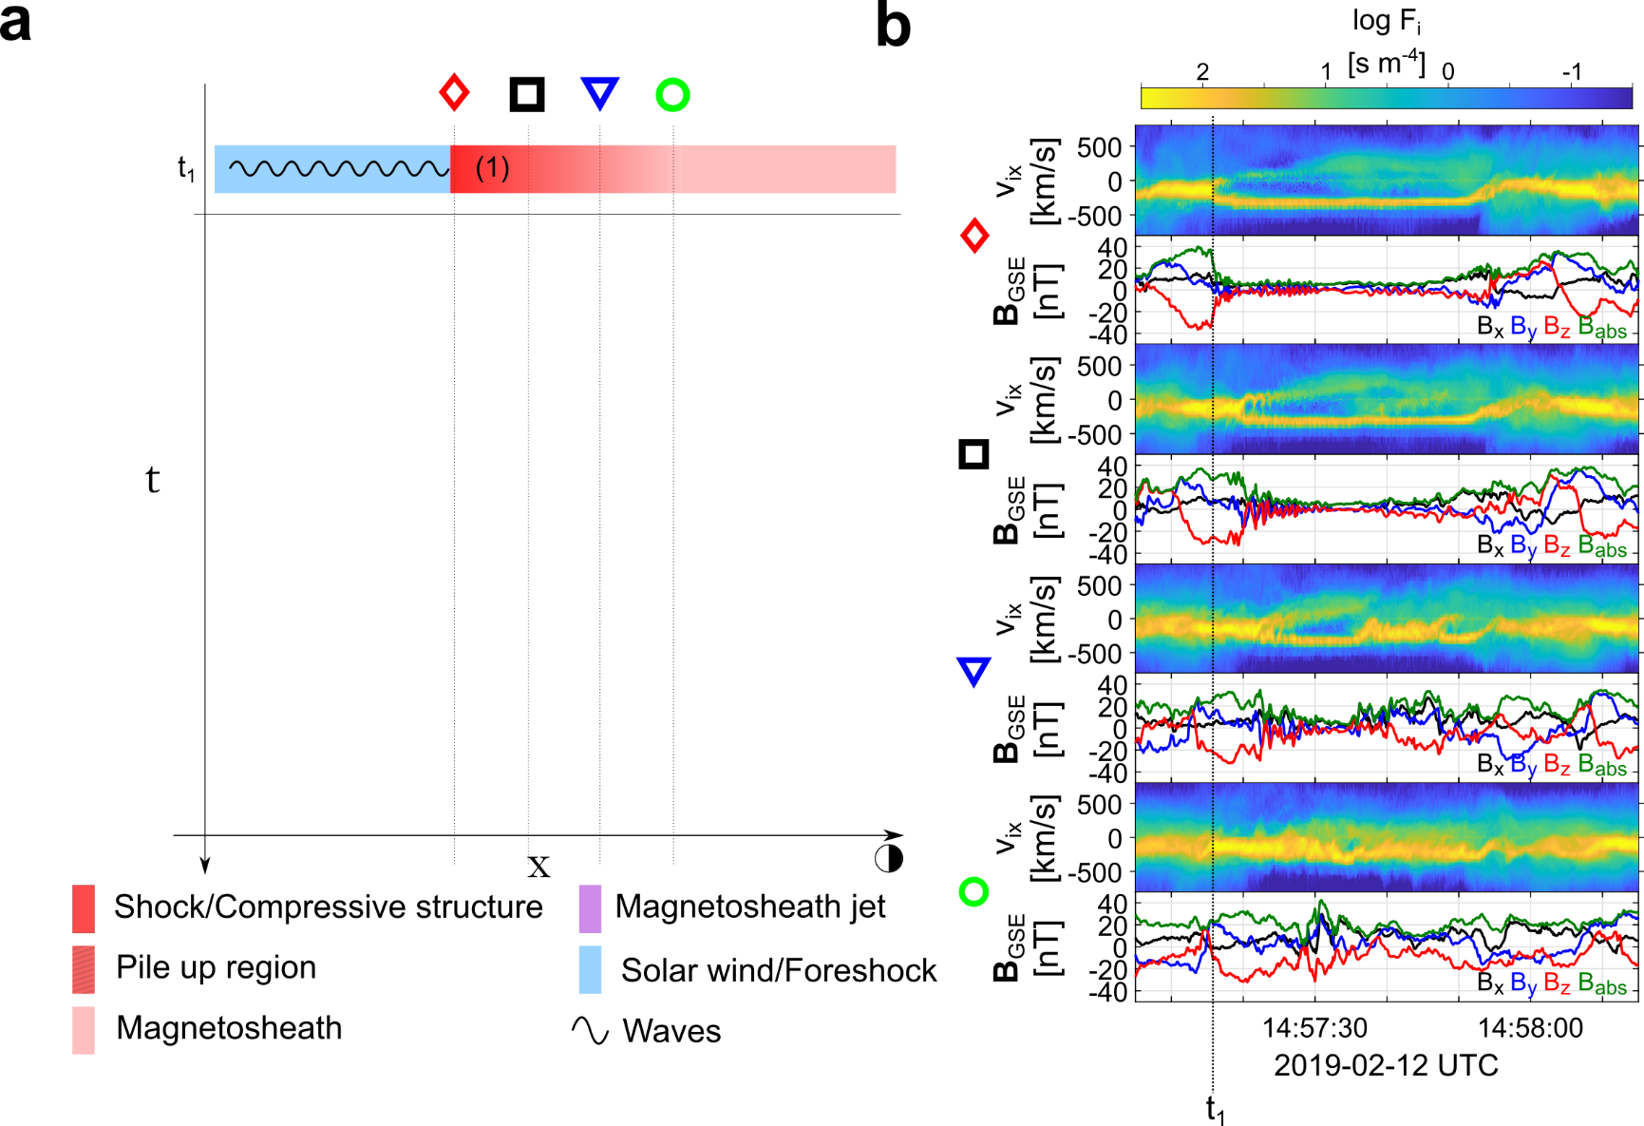
Formation mechanism
Raptis S., et al. 2022a | Nat. Commun.

Slide 41
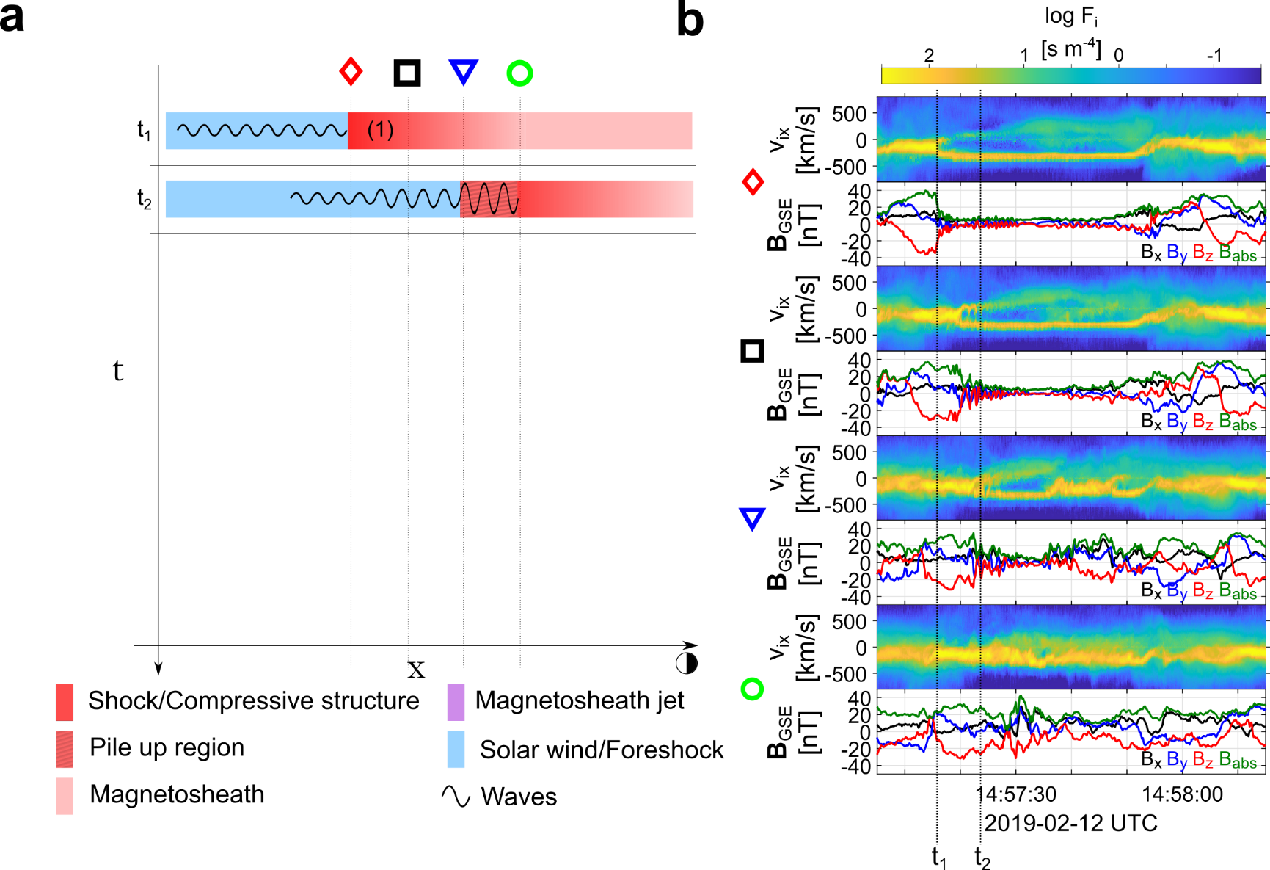
Formation mechanism
Raptis S., et al. 2022a | Nat. Commun.

Slide 42
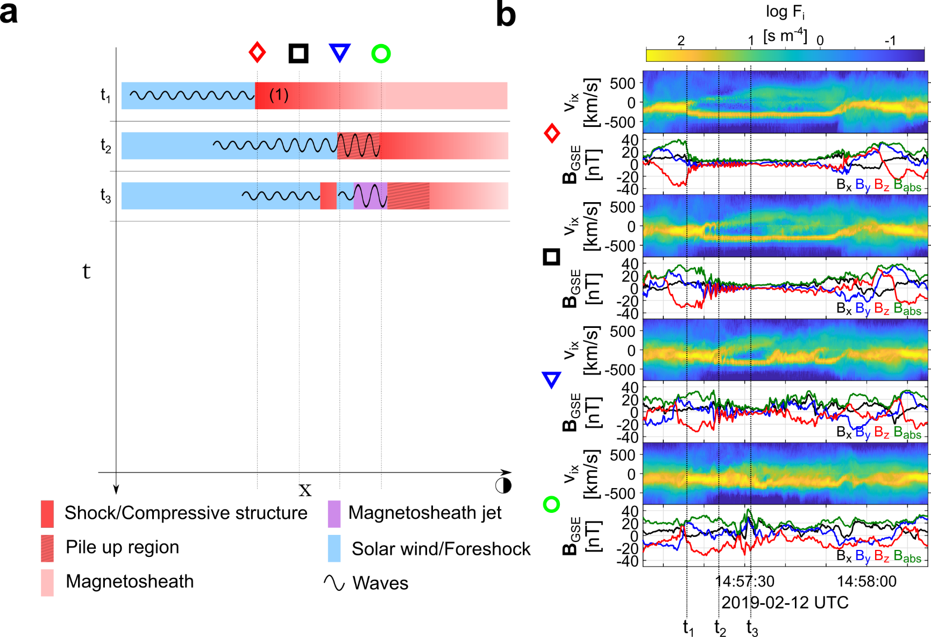
Formation mechanism
Raptis S., et al. 2022a | Nat. Commun.

Slide 43
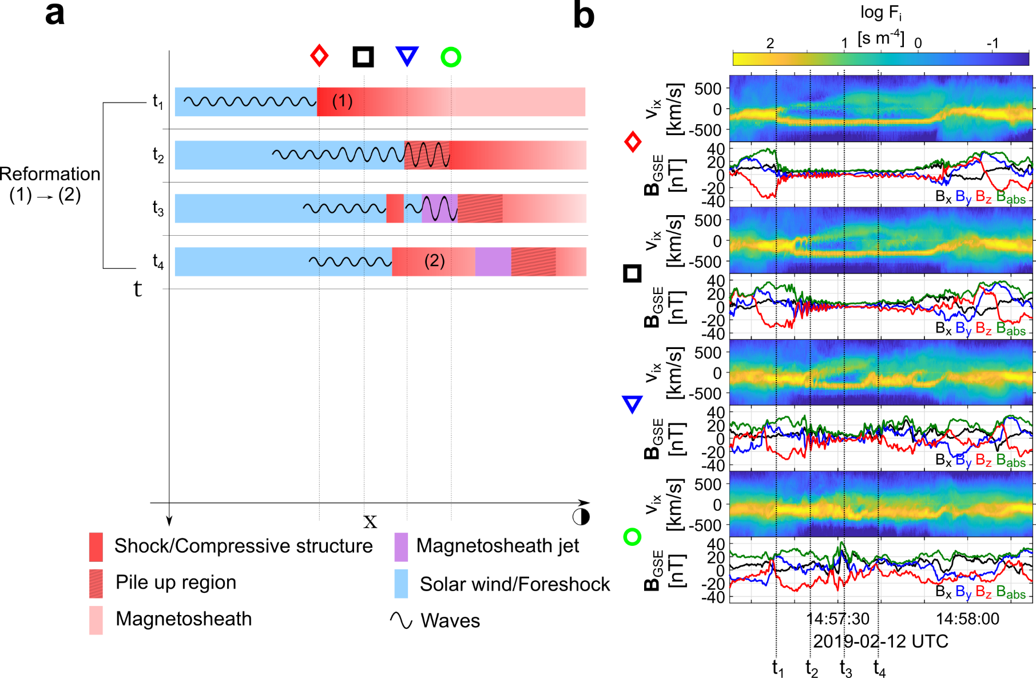
Formation mechanism
Raptis S., et al. 2022a | Nat. Commun.

Slide 44
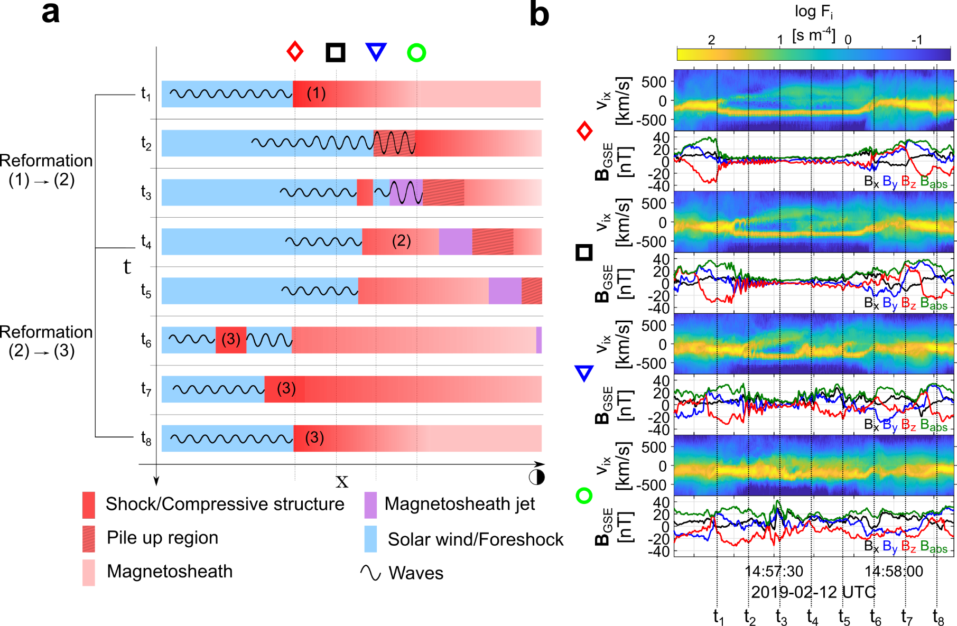
Formation mechanism
Raptis S., et al. 2022a | Nat. Commun.

Slide 45
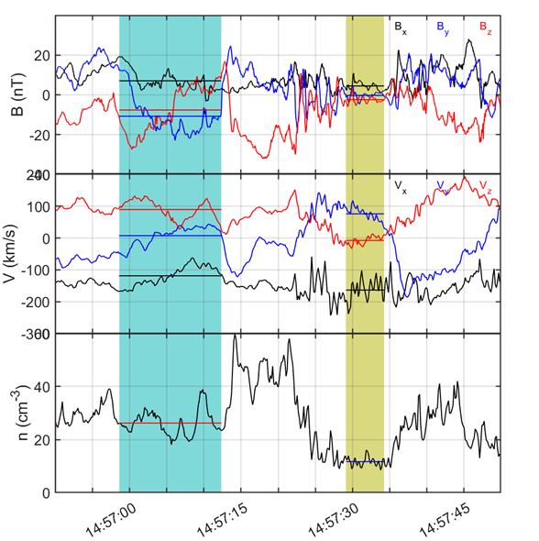

Local & Global Shock properties
Local Measurements (e.g., MMS4)
$$θ_{Bn}≈65−80°$$
Global BS model (e.g., Farris et al.)
$$θ_{Bn}≈25°$$
Consistent with FCS (i.e., SLAMS) acting locally as Qperp shocks.
Turner et al. 2021 (HFA):
38.5 (“global” shock)
80.3 (“local” shock)
Unpublished data - ongoing

Slide 46


Qpar magnetosheath jet – Burst data
Areas of interest
Pre jet = Typical MSH
$t_{1}=P_{dyn}$ peak
$t_{2}=|V|$ peak
Raptis S, et al,. 2022b | GRL

Slide 47
Burst data show jets = SW
Raptis S, et al,. 2022b | GRL

Slide 48

Classification Cluster
Karlsson T., Raptis S., et al. (2021) | JGR

Slide 49



Summarized properties – Quasi parallel
Most common
High dynamic pressure
Primarily Earthward
Associated with low temperature (ΔΤ)
Associated with high |B| & ΔΒ
Δβ<0
Qpar Jet
Jets found in $Q_{∥}$ MSH
Raptis S., Karlsson T., et al. (2020) | JGR

Slide 50


Summarized properties – Quasi perpendicular
Less common
Less Energetic
Mainly velocity driven
Very small duration (~4 sec)
Could be connected to MSH reconnection, mirror mode waves or FTEs
Qperp Jet
Jets found in $Q_{⊥}$MSH
Raptis S., Karlsson T., et al. (2020) | JGR

Slide 51




Example: statistics of subset close to bow shock
$$n=90$$
$95\% CI:[−0.81 , −0.6$]
$95\% CI:[0.27 , 0.62$]
(unpublished data – Ongoing work)

Slide 52

Errors on fitted quantities
Raptis S, et al,. 2022b | GRL

Slide 53





Scale comparison (e.g., Turner et al. 2021)
Hot Flow Anomaly (HFA) self-reformation
SLAMS self-reformation
n = [- 0.540, 0.379, 0.737]
$$v_{SH}=−62.1\frac{km}{s}$$
MC: [0.9026, 0.0987, -0.4191]
MVA: [-0.97, 0.16, -0.19]
$$v_{SH}=\sim 60\frac{km}{s}$$
New Shock ramp ~5 sec
New Shock ramp ~3-5 sec
New ramp ~150km ~2 $L_{i}$
∼1Li and then growing to ∼2Li
$$L_{e} = \sim 2 km$$
$$L_{i} = \sim 90 km$$
$$L_{d} = \sim 13 m$$
$$L_{e} = \sim 2 km$$
$$L_{i} = \sim 80 km$$
$$L_{d} = \sim 10 m$$
“very” rough comparison
Notes:
$$r_{cp}\sim 50−700 km$$

